Slide 1

Introduction of the Household-account Support Service “Zaim”
November 2015
Zaim, Inc.

Slide 2

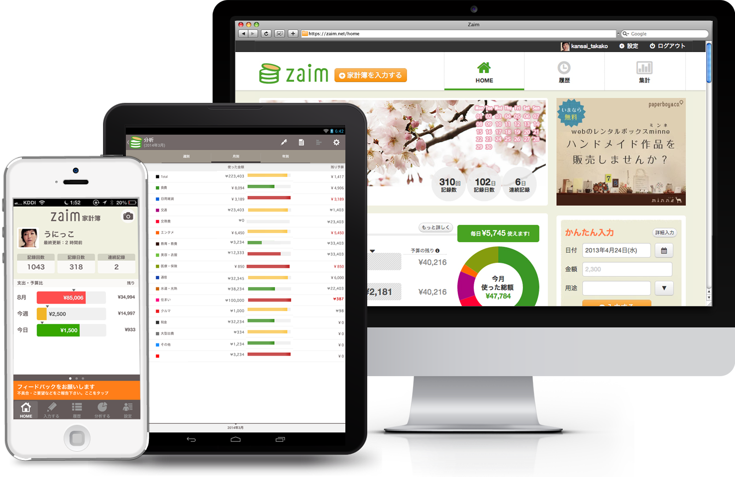



Household-account support service “Zaim”
 | Japan’s largest-class on-line household account system
1st Place:
App Store
(among its entire sales)
1st Place:
Google Play
(Finance Sector)
1st Place:
Nikkei Newspaper
(Household-account
application ranking)
Start of services
iPhone : July 2011 use fee free
iPad : January 2012
Android : March 2012
Web : April 2013
Windows : June 2015
(partially with fee)
Down-loaded:
4.5 million
times
CONFIDENTIAL

Slide 3
Utilization of Open Data

Slide 4
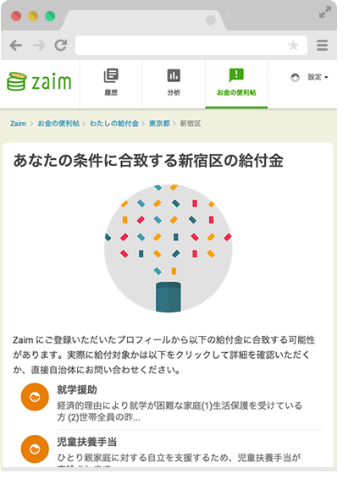
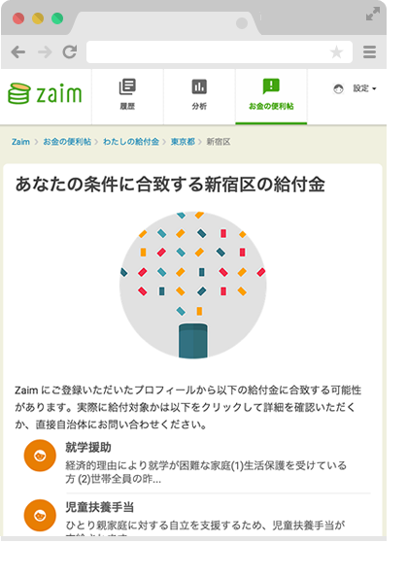
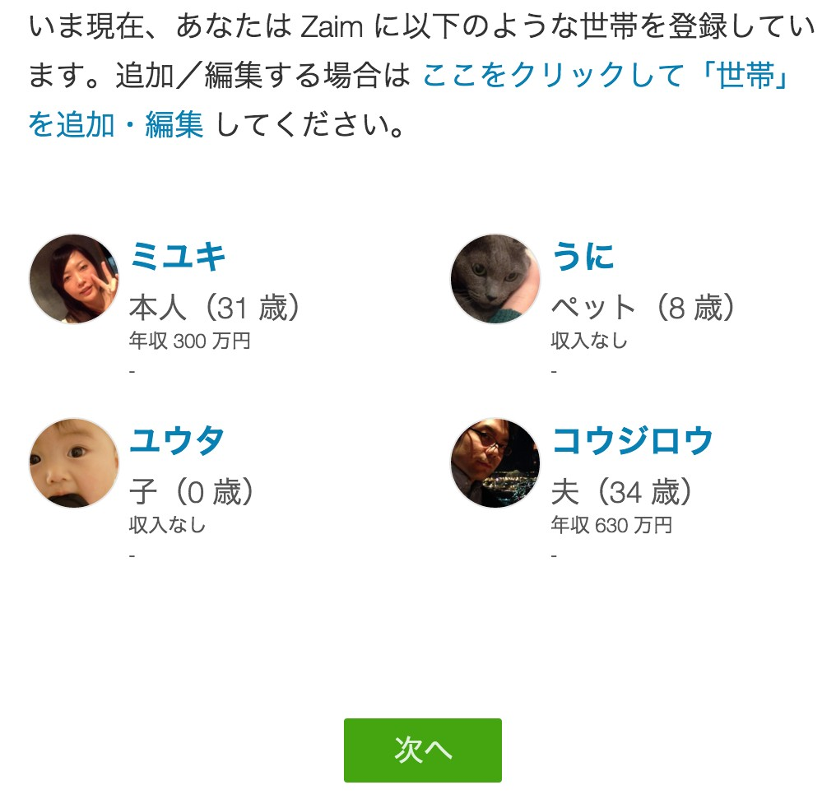
Example 1: My benefits/pensions
Information on the benefits and pensions from 1,718 municipalities is collected and inputted by human power.
Benefits/pensions from Shinjuku Ward that suit your conditions
Presently, the following family members are registered with Zaim.
To add/edit the content of your family members, please click there.
Benefits/pensions from Shinjuku Ward that suit your conditions
From the profile you registered with Zaim, the following benefits/pensions may suit your family members. In order to verify if they are actually suitable to the benefits/pensions, please click on the below-indicated item(s) or contact your municipal agency directly.
CONFIDENTIAL

Slide 5
Example 1: My benefits/pensions
Unique benefits/pensions buried and not well known in various municipalities
Max.
\30,000
Chippubetsu-Town, Hokkaido
“Subsidy to Gatherings of Alumuni held in the Town”
Max.
\10,000
Kamisu City, Ibaraki Prefecture
“Subsidy to Sterilization/
Emasculation Operations for Dogs and cats”
\20,000 or more per month
Nagano City, Nagano Prefecture
“Subsidy to Housing by Young People”
Max.
\240,000
Kotohira City, Kagawa Prefecture
“New Couples Welcoming Business”
CONFIDENTIAL

Slide 6
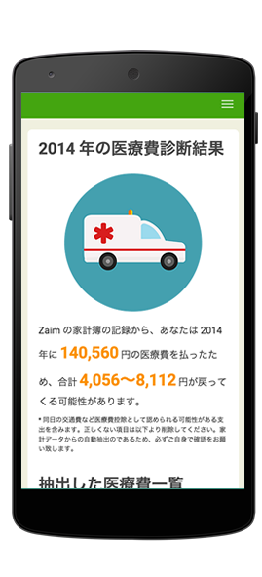
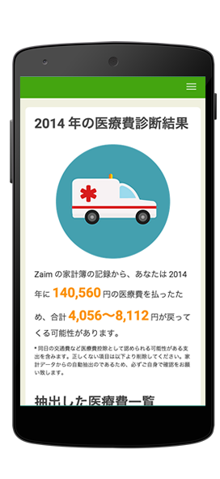
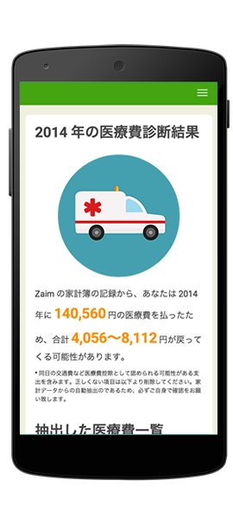
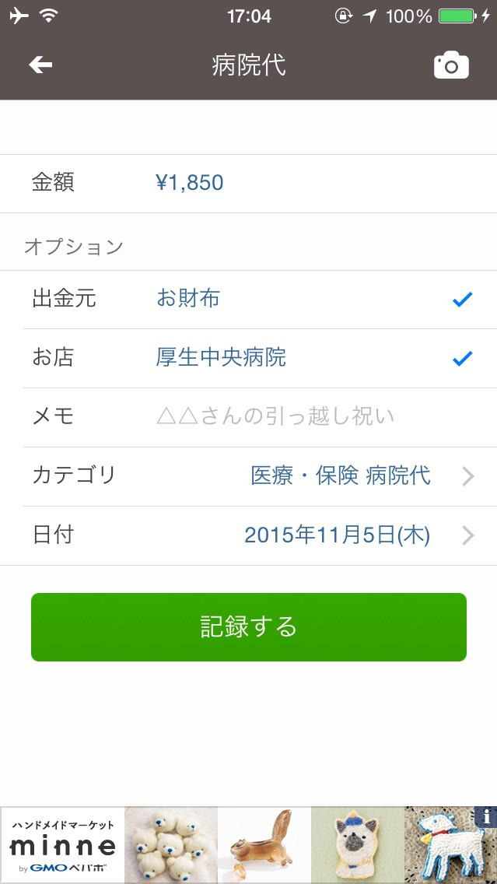
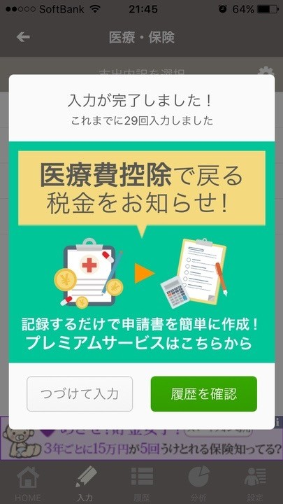
Example 2: My Medical Deduction
Public information is extracted and notified from your household-account and/or information about your household members.
(1) Medical expenses are inputted.
(2) Deduction tool is informed.
(3) Diagnostics results are displayed.
CONFIDENTIAL

Slide 7
info@zaim.net

