Slide 1

Confidential
Unauthorized reproduction prohibited
This material reflects the situation as of November 20, 2015
WELMO Inc.

Slide 2
Mr. Yusuke KANO
President and CEO, WELMO Inc.
Born in Toyonaka City, Osaka Prefecture. After graduating from Ritsumeikan Asia Pacific University, started to work in Tokyo. After working as a volunteer and as a visitor at care houses in Sendai, Tokyo and Fukuoka for 8 months, established WELMO in Fukuoka.
Lecturing, etc. : Lecturer (in charge of welfare venture theory) at Division of Social Welfare, Department of Human Sciences, Seinan Gakuin University (industry-academia-government collaborative lecture); Lecturer at seminars for regional welfare social workers organized by Fukuoka-City Council of Social Welfare; Lecturer at Graduate School of Management, Globis University; Consultant for intermediary support and life support model businesses, entrusted by municipalities, etc.
Work experience: Worked as a consultant for human-resources management ERP introduction in the Personnel Department of a company listed in the first section of the Tokyo Stock Exchange. Worked also as a consultant for HRM/ERP introduction at Works Applications Co., Ltd.
Details: Engaged in the management of and preparation for personnel/labor auditing of HRP/ERP introduction projects for companies having the number of employees from 3,000 to 160,000.
WELMO Inc.

Slide 3
Introduction of management staff members
Mr. Ryunosuke FUKAI, Chief Strategy Officer
Graduated from Department of Literature (Social Study), Kyushu University
2009 Joined Toshiba Corporation. Assigned to its Department of Management and Planning of the Headquarters.
Took charge of management and planning of a business unit having an annual sales volume of around 15 million yen in Semi-conductor Operations Department. Participated in projects to transfer production capability to overseas.
2011 Became an independent consultant in 2011. Promoted planning and implementation of large automobile-manufacturing group companies, as well as those of new businesses initiated by publishing companies and entertainment production companies.
2013 Joined “REEVO”, an electric automobile venture company in Fukuoka, and assumed the post of Director & COO.
Took charge of such matters as corporate reconstruction, new services development promotion, examination of business risks, streamlining of organization, management of recruiting employees and their inter-office educational procedures, business planning and implementation, and overall business promotion.
Joined WELMO to contribute to the field of care and welfare and to the country, after having problem consciousness with care and welfare services when grandmother entered a care house.
Mr. Masamoto NOTSUKA, Chief Marketing Officer
Graduated from Faculty of Law, the University of Tokyo
(graduated from Nada Junior High School/High School)
2008 Joined NTT Docomo, Inc. Supervised Docomo shops in the areas of Shinjuku and Ikebukuro.
2011 Worked in the Department of Marketing of NTT Docomo (responsible for marketing strategies). Involved in the drawing of the royalty marketing overall strategy, and in the drawing of the segment strategy for kids and senior people.
2014 Moved to a consulting company and involved in the improvement of educational and financial industries, with the UI improvement of WEB and smartphones as his core job.
Made a U-turn to his family business (hospital) in Nagasaki and involved in its management and planning.
Joined WELMO, feeling sympathy with the innovation in the field of social welfare.

Slide 4
Introduction of management staff members
Mr. Yoshinobu KATSUHARA
Worked thus far for 6 years in the care and welfare industry.
2009 Joined Asahi Clean, a home-visit bathing care company, and worked as the head of 3 business offices simultaneously.
2012 Recruited by Sakura Kaigo Group (care business) as a supervisor and took charge of consulting and franchising management for a variety of care houses.
Joined WELMO after being involved in the establishment of more than 10 new care houses.
Ms. Mitsue OKUMURA, General Manager,
Educational Business for the Handicapped
Graduated from School of Social Welfare, Bukkyo University
Involved in the care and welfare industry for 13 years.
2004 Joined Sakura Kaigo Group (a franchiser of care offices), after experiencing home-visit care management for 4 years, and took charge of administrating general care and home-visit care businesses for the handicapped.
2005 Became Supervisor and General Manager for home-visit, in-house and day service businesses.
Joined WELMO, after being engaged in the establishment of more than 30 new care houses and having attained 53 million yen per month of revenues.

Slide 5
Trade Name | Welmo, Inc.
Capital | \28,250,000.- (including \9,825,000.- each from 2 VC, and investment from 1 CVC)
Head Office | 4th floor, Fukuoka-Higashi Government Office Building, Fukuoka Prefecture, 1-17-1 East, Hakata Station, Hakata Ward, Fukuoka City, Fukuoka Prefecture
Foundation | April 30, 2013
Main business activities | Software package development in the field of welfare. Provision of collaborative information services among care houses in specific areas, etc.
Main customers, cooperative partners | Fukuoka Prefecture, Fukuoka City, Fukuoka City Medical Association, Fukuoka City Council of Social Welfare, Tsukui Corporation, FCO-OP Fukuoka, (and other 338 operational care houses in Fukuoka City)
Notes:
離職率

Slide 6


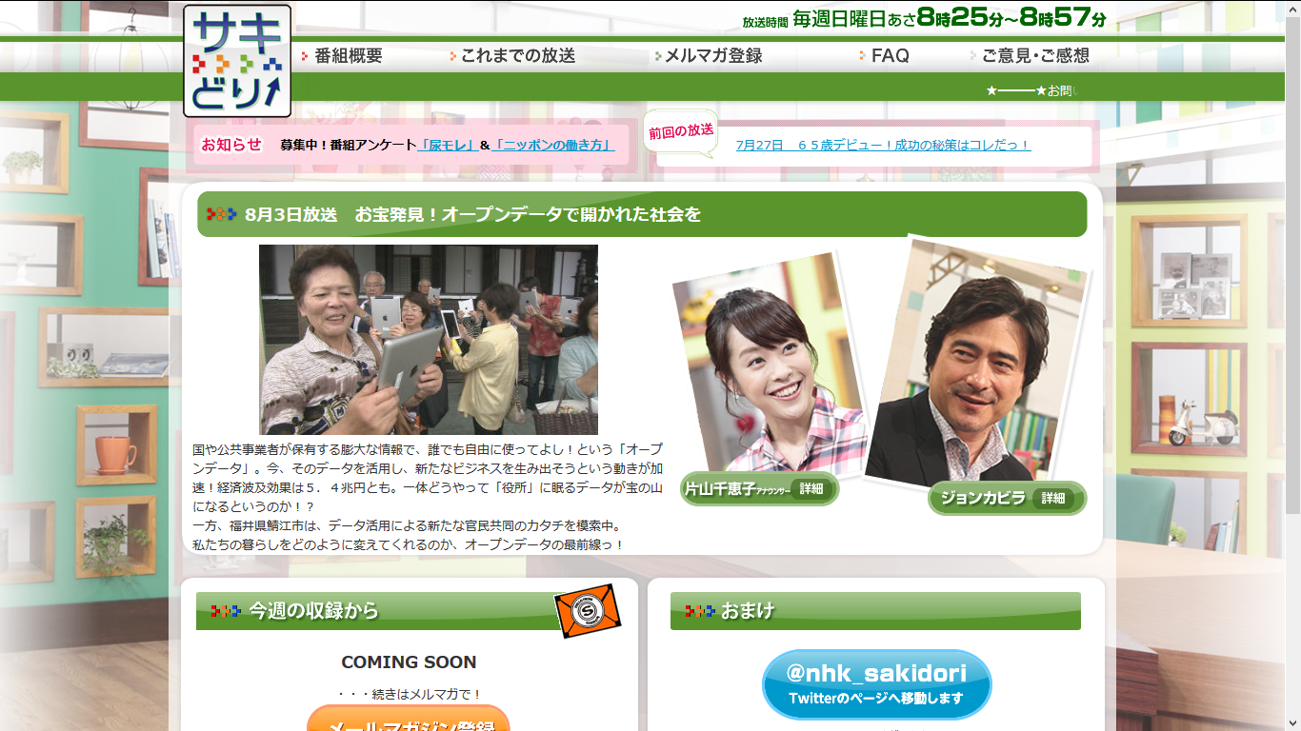
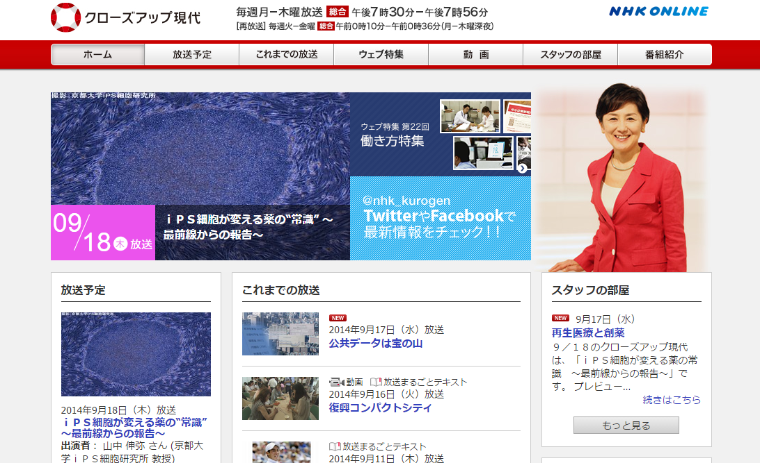
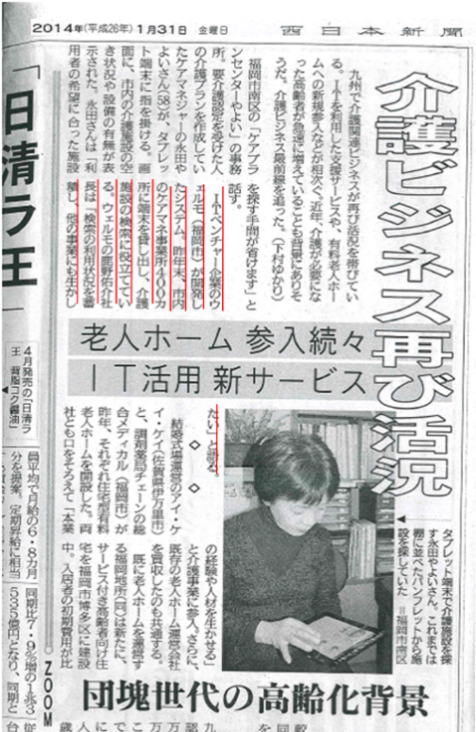
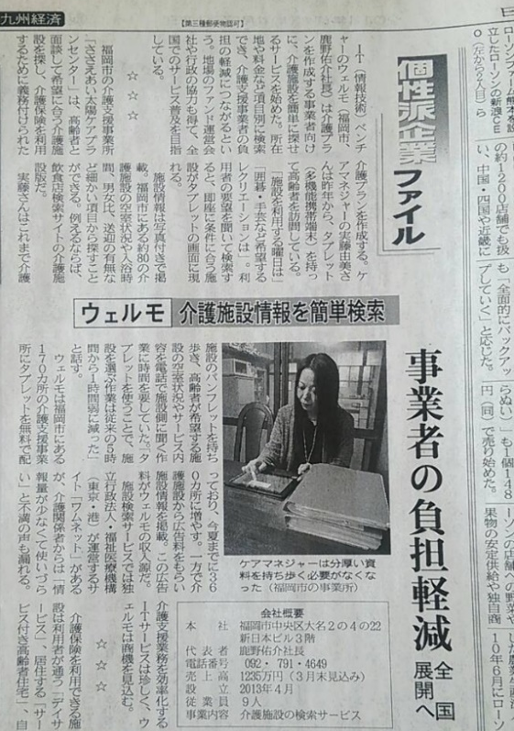
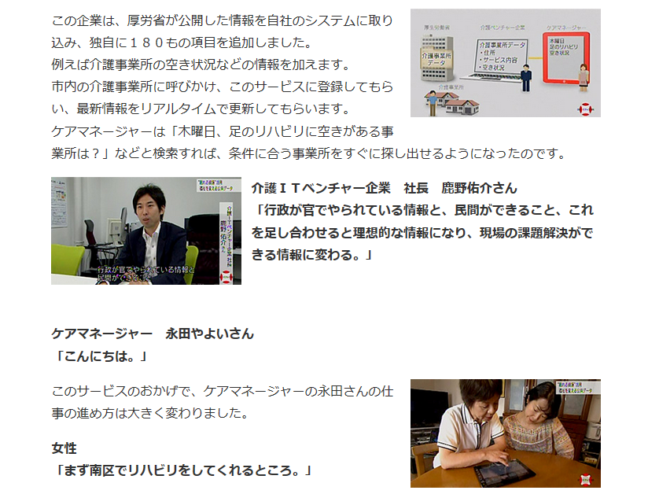
Some excerpts from media, newspapers and TV programs
NHK Close-up Gendai, Saki-dori (TV program), The Nihon Keizai Shibun (newspaper),
The Sankei Shimbun (newspaper), The Nishi-Nihon Shimbun (newspaper),
Zaikai-Kyushu (monthly magazine), Teikoku Databank, Japan Microsoft, etc.

Slide 7
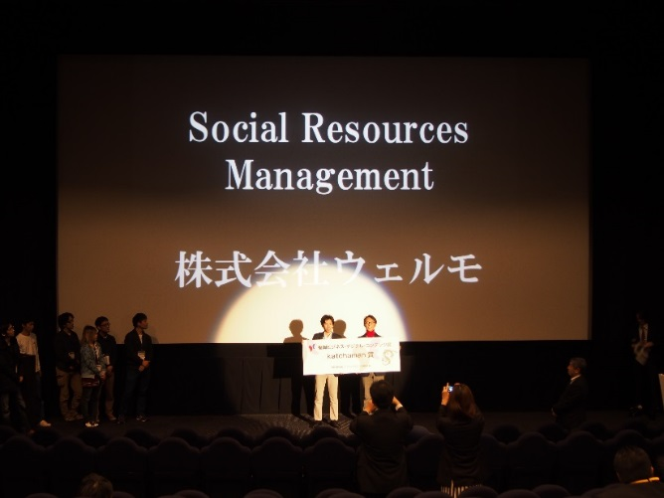
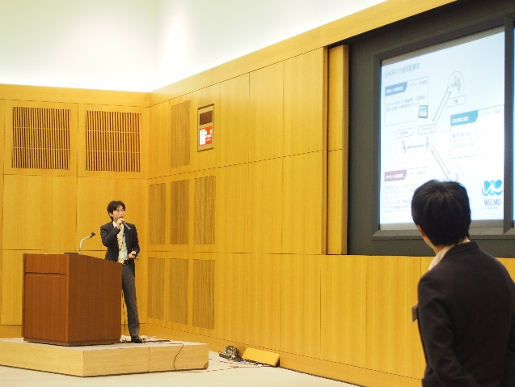
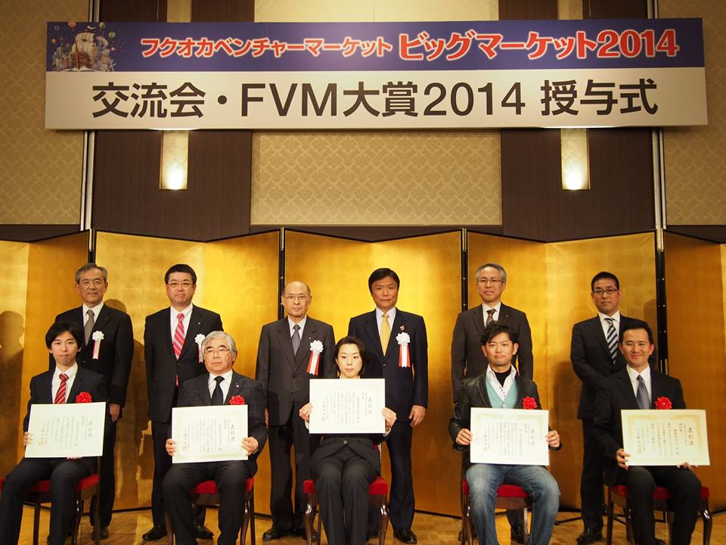
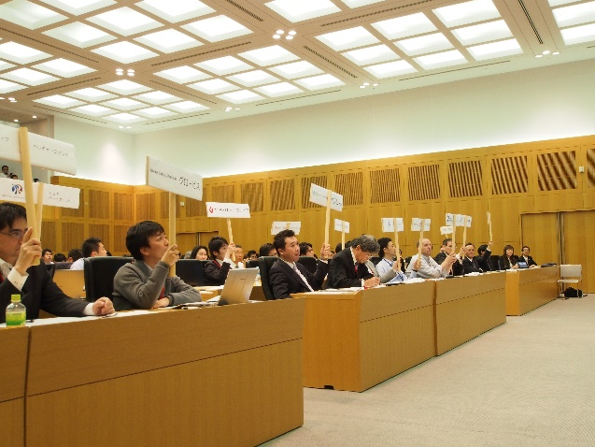
Awards received:
Fukuoka Business Digital Contents Awards, sponsored by Fukuoka Prefecture
(February 2014, and February 2015)
NTT-Data Open Innovation Contest
2014 BeSTA Award
Microsoft Bizpark 2014-15
Entrepreneurs’ Challenge, sponsored by MIC’s National Institute of Information and Communications Technology (NICT)
2015 NICT Award
2014 Award of Excellence
2014 Chief Juror Award
2015 Award of Excellence
Fukuoka Venture Market Award 2014, sponsored by Fukuoka Prefecture
(February 2014)
Kyushu Startup Pavilion 2014,
sponsored by Tohmatsu Venture Support Co., Ltd. and DOGAN, Inc. (April 22014)
The Highest Award
(All participating VCs voted for this Award for Welmo.)
Special Award
小川県知事同席

Slide 8
We face a reality that citizens
are not able to choose
appropriate welfare services
because of a situation where information related to the care field
is not properly revealed.
9
Copyright © 2015 WELMO INC. All Rights Reserved.

Slide 9

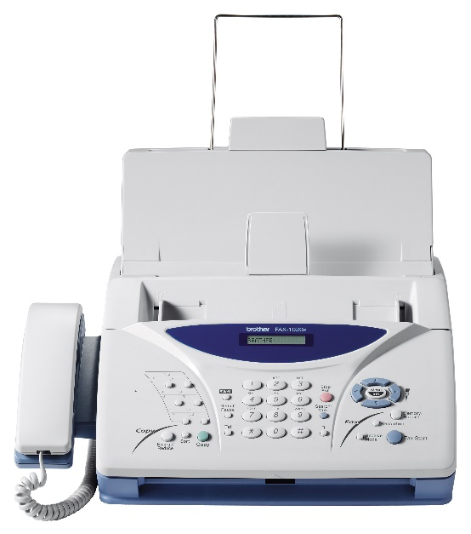
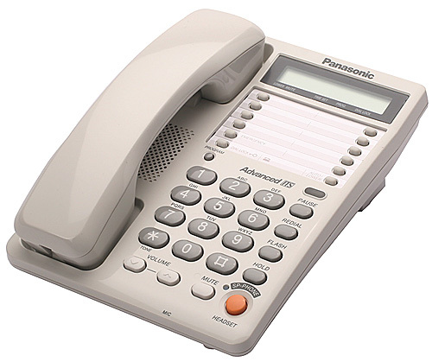
Means for information sharing
in the care industry
11
Copyright © 2015 WELMO INC. All Rights Reserved.

Slide 10

Home-visit care service
Home-visit bathing service
Home-visit nursing service
Home-visit rehabilitation service
Day care service
Day care rehabilitation service
Short-term-stay life care service
Short-term nursing and care service
In-home-nursing management and guidance service
Life care service for persons dwelling in specified facilities
Welfare equipment lending service
Home-visit care service with special conditions for night-time care
Day care service for dementia persons
Small-sized, multifunctional in-home care service
Cohabitation life care service for dementia persons
Community-based life care service for persons dwelling in specified facilities
Community-based welfare facilities for the elderly
and the like
ケアマネジャー
福岡市7区
(MSW・仲介会社)
2,105 care houses in 7 Wards in Fukuoka City
12
Copyright © 2015 WELMO INC. All Rights Reserved.

Slide 11
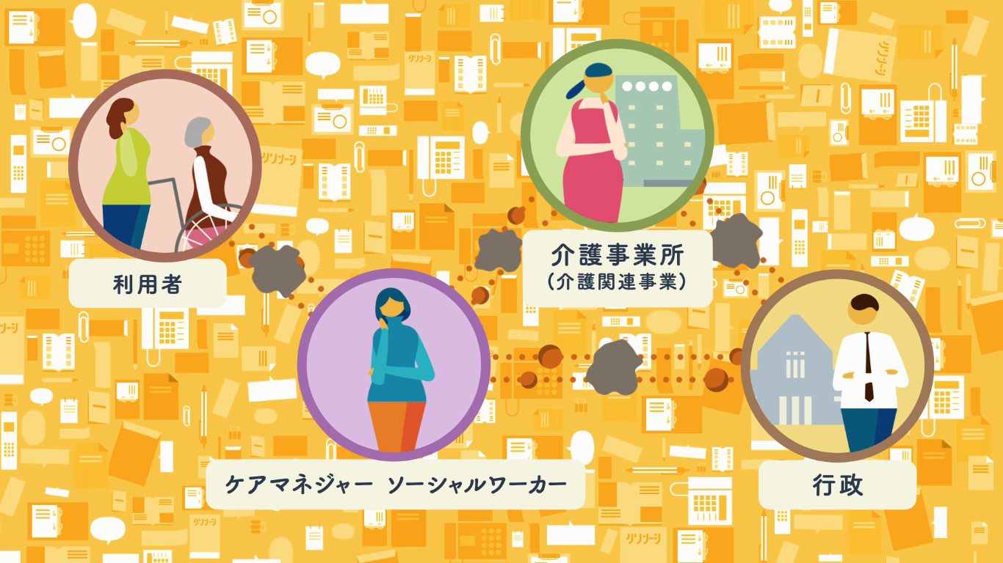

Slide 12






Because the internal conditions of and actual information about care houses are not well-known to outsiders (i.e. they are kept in the black box), we have no other way than visiting them personally or making speculations from pamphlets to get information.
ケアマネージャー
銀行・企業・医療法人・行政など
・よくわかる施設は数十カ所だけで
利用者に対して旧知の施設しか紹介
できていない
・事業所数が多く物理的な時間の制約上
把握数が限られる
・事業所に対して審査をするのにコストがかかる
・生保営業は介護についてわからないので
営業機会損失をしている
・新しく介護事業所を立ち上げたいが、
どこに何を建てたらよいかわからない
・介護業界の特殊性により営業が出来ない
高齢者住宅仲介
利用者（一般市民）
・各社老人ホームを一件、一件訪問して
情報を得ている
・空室などの情報については随時
問い合わせしている
・事業所数が多いがサービスの情報が少ない
・そもそも、どんな事業所があるかわからない
・事業所の質がわからない
・自分に事業所が合うかどうかがわからない
・料金が分からない
Difficult to get access to information about care houses
Care houses
2,105 care houses in Fukuoka City
介護事業所
14

Slide 13

We sort out various kinds of information and make standardization so that people requiring information can get necessary information.
ケアマネ向けの情報
銀行等の市場情報
介護事業所
利用者向けの情報
高齢者住宅仲介向けの情報
15

Slide 14

Open data are added
We transform information we collected from care houses
through our cloud system to high-value information with a wide coverage, by putting together detailed real-time information and general open data.
Our company’s independent data:
to express superiority or inferiority
Transforming to valuable information for citizens
Open data:
to guarantee impartiality
1. Basic information
Address
License number given to the care house
Countable information
Distribution of workers, etc.
2. Peripheral information such as regulations and administrative services
Outline of the public health care insurance
Welfare conditions for the disabled in Fukuoka City
List of responsible public offices and their contact addresses/telephone numbers
* Digitalization of the above information is permitted by Fukuoka City.

Slide 15
About the contents of data
Social resources database created through our company’s tablet and cloud services for care houses is constructed on Microsoft Azure.
* Social resources: Funds to support social welfare, as well as goods and labor force required to formulate social welfare, such as facilities, institutions, and human resources.
18 months after the release
Care information
Administrative information
Fukuoka City Comprehensive Support Center
95% of share
Information on facilities
Information collected by own expenses
Information on human resources
Information on the care system
Information on the system for the disabled
Information on the national pension plan
Social resources databank
Social resources management by WELMO
Tablets for care managers
66% of share
Centralization of information
Care houses covered by the cloud CRM
27% of share
Community information
Related information
* The rate of introduction is calculated from the total number of facilities for the relevant month within Fukuoka City.
Information on life support
Information on volunteers
Information on doctors, medicines and available home-visiting doctors
Information on the availability of welfare equipment
Information on food deliveries and taxis for the aged/disabled
Information on hospitals
Notes:
離職率

Slide 16



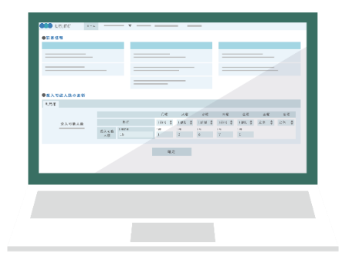
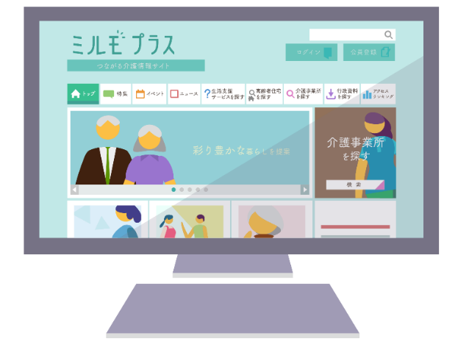

Care manager
Social worker
Broker of residences for the elderly
16

Slide 17

Support for business management and information-dispatch operations of care houses, in the situation where the number of competitors has increased because of the expanded market due to the public care insurance.
17

Slide 18

“Dispatch of visual and accurate information” from “Regional Comprehensive Support Center for Care Managers” to users.
18

Slide 19

BtoB portal service for community-specialized, care-related information: From the information about available rooms for the elderly to the information about the details of services.
19

Slide 20
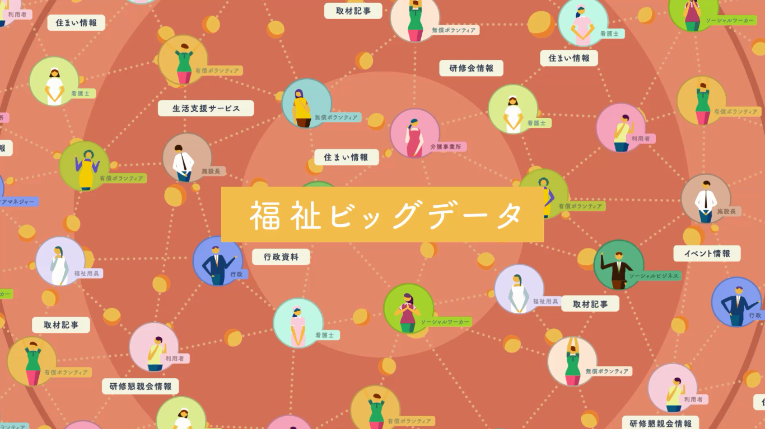

Slide 21


Rate of introduction in 18 months after the release
Fukuoka City Comprehensive Support Center
Share of MILMO tablets:
94.9
%
Houses in 7 Wards in Fukuoka City
Share of MILMO tablets:
65.8
%
Notes:
9営業日でシェア4.0%

Slide 22

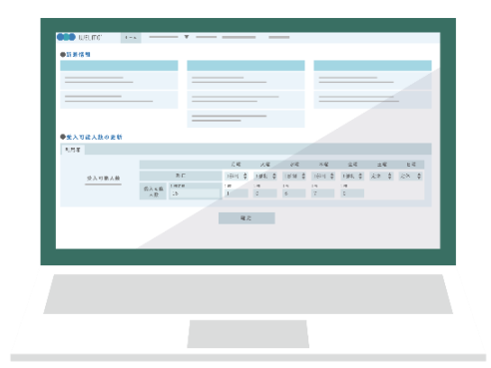
Rate of introduction within 18 months after the release
27.0
Care houses in 7 Wards in Fukuoka City
Introduction share of MILMO PRO:
%

Slide 23
Our mission is to make
the care market transparent,
by effectively utilizing information.
In Japan, while the ageing of the population is progressing, transparency of the care industry is not much advancing due to complicated manual and paper-based work.
１．Due to the lack of transparency and a well-developed market,
care houses are tend to be chosen,
not by their quality but by the chance.
→Offices with high quality are not necessarily spotlighted.
２．Operational communication costs in the businesses related to the public care insurance are increasing.
→The benefit-cost ratio for care-related QOL based on the tax is not good.
→Because of high operational costs of the care business, it is difficult for other types of industries to enter the care industry.
→The above factors, combined with the economy of the unprofitable care insurance system, are hindering innovations in the care industry.

