Slide 1

Open Data Symposium 2015
From Disclosure to Utilization
How Open Data Can Be Utilized for Regional Vitalization?
Ken Sakamura
Professor, the University of Tokyo ; Director, YRP Ubiquitous Networking Laboratory ; President, Vitalizing Local Economy Organization by Open Data & Big Data (VLED) ; President, Association for Open Data of Public Transportation

Slide 2
■Definition : Providing Information with Highly Public Characteristics on Open License Basis to Anyone for Their Free Compilation and Processing, etc.
Open Data
▶ Sector-wise, it means public administration information in a narrow sense, while in a broad sense it includes information provided by private businesses and individuals.
▶ From the viewpoint of openness, the strictest definition of open data disqualifies those with restriction on information attribute or sharing.
http://opendefinition.org/ (Open Definition)

Slide 3
Open Data to begin with …
iii, The University of Tokyo
At the time of the inauguration of the US President Obama
Year 2009

Slide 4
Desire to Keep Growing without Funds,
Desire to Decrease Budget Outlay
iii, The University of Tokyo

Slide 5
From US Success toward Other Parts of the World ….
iii, The University of Tokyo

Slide 6
For Example, the London Olympics
iii, The University of Tokyo

Slide 7
iii, The University of Tokyo
Then, the Joint Communique issued at G8 Summit in 2014
Open Data Charter

Slide 8
PART 1
Situation of Open Data in Japan
iii, The University of Tokyo

Slide 9
iii, The University of Tokyo
1-1
Situation at the Government Level

Slide 10





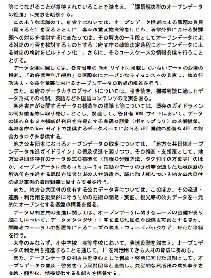


Revision of “Declaration of Creation of the World’s Cutting-Edge Information Technology State”
■ IT Strategic Headquarters, Cabinet Secretariat revised the “Declaration of Creation of the World’s Cutting-Edge IT State” (June 30, 2015)
■ From the Summary of Activities in 2013 to
2015
▶ Appreciation of Full-Scale Operation of the Japanese Government’s Data Catalogue Site "data.go.jp" with the Collection of 13,038 Data Sets.
■ Succession of Promotion of Open Data
▶Consciousness of Promotion of Open Data Utilization
▶ Promotion of Problem-Solving Type Open Data
▶ Promotion of Automatic Adoption of Policy-Making Methods Utilizing Open Data in Government Offices
▶ Review of the Government’s Standard Open Data Utilization Agreement, and Its Consistency with the International Open Data License
▶ Consolidation of Open Data Vocabulary and API
▶ Promotion of the Guideline of Open Data Promotion for Local Authorities, and Its Utilization for Solution of Local Issues
▶ Promotion of International Extension of Open Data
▶ Activities for the Establishment of International Documentation (Global Index) and Strengthening of Overseas Publicity

Slide 11

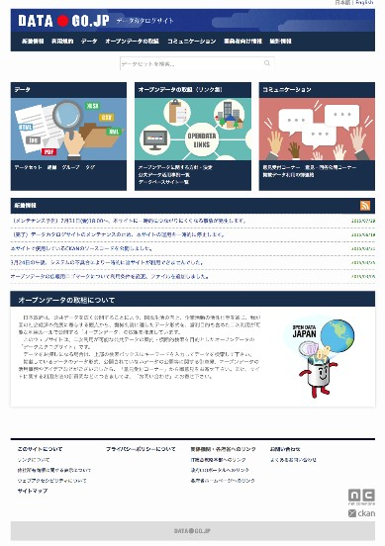
Initiation of Full-Scale Operation of Japanese Government’s Catalogue Site（data.go.jp）

Slide 12
Environment Improvement for Promotion of Open Data
(Activities of Senior Officials’ Meeting of E. Administration Open Data, Cabinet Secretariat)
■ Various documents have been revised or renewed.
■ Toward the Renewed Development of Open Data（2015.6.30）
▶ （Summary）https://www.kantei.go.jp/jp/singi/it2/densi/aratanaod/aratanaod_gaiyou.pdf
▶ （Main Text）https://www.kantei.go.jp/jp/singi/it2/densi/aratanaod/aratanaod.pdf
■ Road Map for Promotion of E. Administration Open Data （2015.6.14）
▶ （Summary）https://www.kantei.go.jp/jp/singi/it2/densi/kettei/rm_gaiyou.pdf
▶ （Main Text）http://www.kantei.go.jp/jp/singi/it2/kettei/pdf/20130614/siryou3.pdf
■ Principles of Government Offices’ Data Disclosure for Promotion of
Their Secondary Use (Guideline)（2015.6.25）
▶ （Summary）https://www.kantei.go.jp/jp/singi/it2/densi/kettei/data/gl26_gaiyou.pdf
▶ （Main Text）https://www.kantei.go.jp/jp/singi/it2/densi/kettei/data/gl26_honbun.pdf
■ Guideline of Open Data Promotion for Local Authorities （Published:
2015.2.12, Guideline Revised: 4.27 ）
▶ （Summary）https://www.kantei.go.jp/jp/singi/it2/densi/kettei/opendate_gaiyou.pdf
▶ （Main Text）https://www.kantei.go.jp/jp/singi/it2/densi/kettei/opendate_guideline.pdf
▶ ”Let’s Start Open Data !”

Slide 13
Development of Comprehensive Strategy for Local Areas
(Prime Minister’s Office： Headquarters of Creation of Town, Human Resources and Jobs)
http://www.kantei.go.jp/jp/singi/sousei/
■ Comprehensive Strategy for Local Areas
▶ Formulation of policy targets and measures for the fiscal 2015 to 2019 (5 years)
based on demographics and industrial agglomerations of each local area.
■ Identification of Local Characteristics and Issues based on Data of Each Area
▶ A system for local economic analysis based on data will be developed by the
government.
▶ The required data analysis and the development of comprehensive strategy for local
areas taking account of local issues will be undertaken by each local authorities.
■ Consideration based on Data at the time of Plan Formulation by Local
Authorities is Essential.
▶ The consolidation of administrative data including open data will be increasingly
required for local authorities.
■ Inclusion of the Policy Decision of Addressing Open Data by Local Authorities
Itself in the Comprehensive Strategy for Local Areas is Desirable.

Slide 14
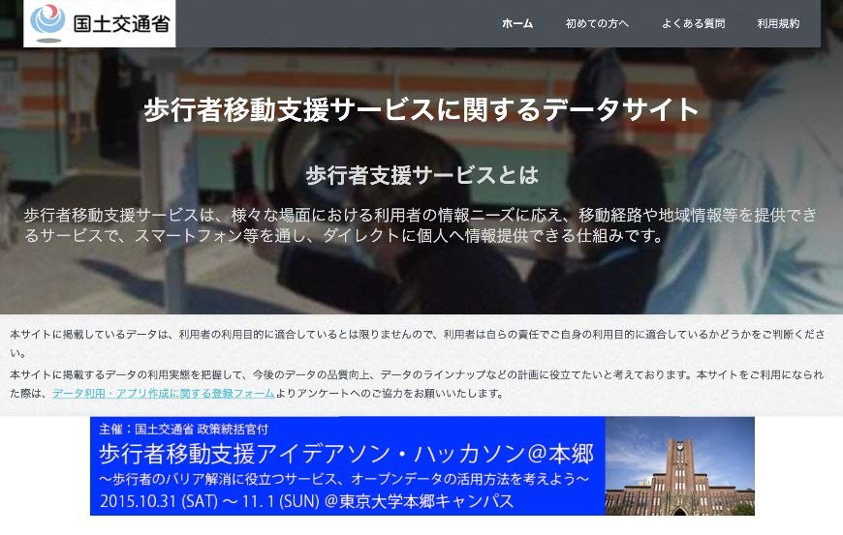
Ministry of Land, Infrastructure, Transport and Tourism :
Open Data for Pedestrian Movement Support Service
https://www.hokoukukan.go.jp/top.html

Slide 15
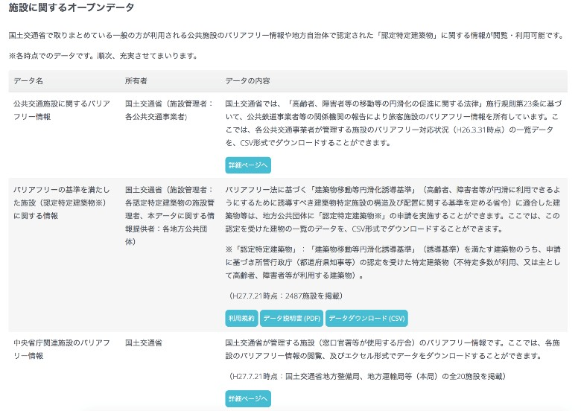
Ministry of Land, Infrastructure, Transport and Tourism :
Open Data for Pedestrian Movement Support Service
https://www.hokoukukan.go.jp/top.html

Slide 16
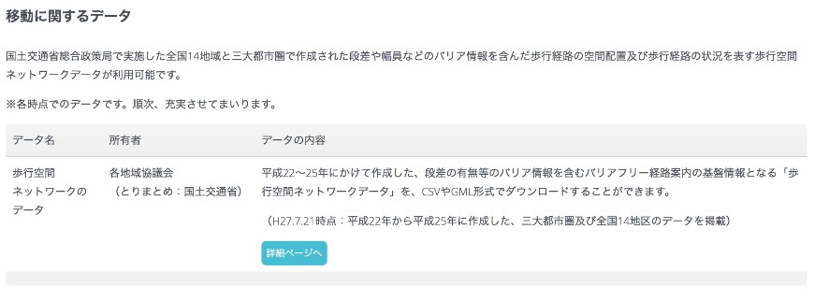
Ministry of Land, Infrastructure, Transport and Tourism :
Open Data for Pedestrian Movement Support Service
https://www.hokoukukan.go.jp/top.html

Slide 17

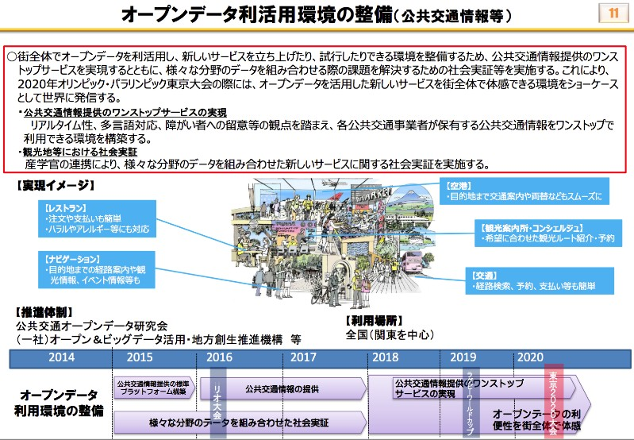
Approach of Open Data for the Year 2020
(MIC Committee for ICT Promotion in the Whole Society of Japan for the Year 2020)

Slide 18
iii, The University of Tokyo
1-2
Progressing Efforts of Local Authorities geared to Open Data

Slide 19
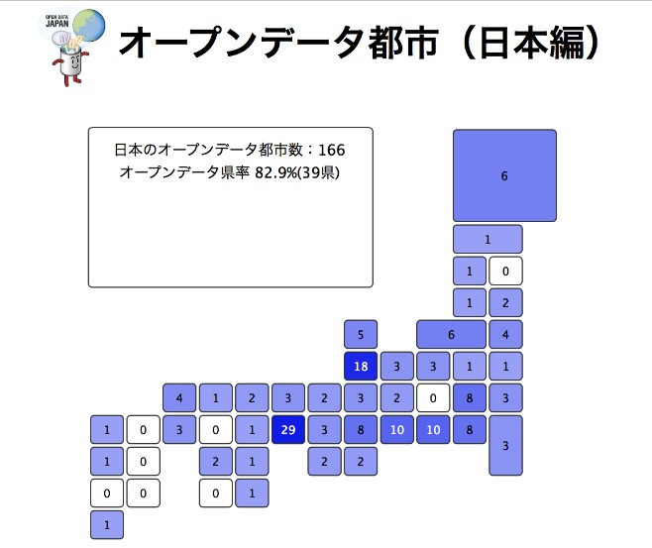
Number of Open Data Cities of Japan = 166 (as of Nov. 22, 2015) http://fukuno.jig.jp/app/opendatacity/

Slide 20

PART 2
iii, The University of Tokyo

Slide 21
For Spreading Open Data in Japan
iii, The University of Tokyo
Enlightenment, Education and Standardization of “Open”

Slide 22


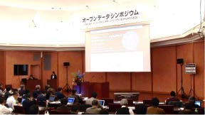
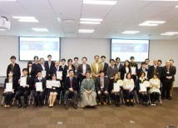
History, Activities So Far, From Disclosure to Utilization and Business Creation
■ Establishment of Open Data Promotion Consortium in July, 2012
▶ Established for the purpose of open data promotion in joint efforts among businesses, government and
academics.
▶ Implemented enlightenment activities through committee works, symposia and contests, etc.
 Published “Open Data Guide” which gave details of methodologies of open data and points of attention for
utilization of open data.
 Organized symposia and commendation at the committee’s discretion for introducing open data activities in Japan
and the world.
 Organized application contests for promotion of open data utilization.
▶ Honored by the Minister of Internal Affairs and Communications for the contribution for the
promotion of increased use of information technology (in the field of business and organization )
in Oct. 2014.
■ Reorganized as VLED in Oct., 2014
▶ Reorganized as a general incorporated association for the purpose of promotion of creation of data-
utilizing new businesses and vitalization of local areas in addition to promotion of data disclosure and
enlightenment supported by Open Data Promotion Consortium.

Slide 23
List of Directors of VLED
■ President
▶ Ken Sakamura （Professor, the University of Tokyo）
■ Vice President
▶ Hiromichi Shinohara（NTT Corporation）
■ Managing Director
▶ Takaaki Shimizu（NEC Corporation）
■ Directors
▶ Kazuhisa Arii (Dentsu Inc.)
▶ Yuriko Inoue (Professor, Hitotsubashi University)
▶ Masashi Usami (KDDI Corporation)
▶ Hiroyoshi Oda (Microsoft Japan Co., Ltd.)
▶ Noboru Koshizuka （Professor, the University of
Tokyo）
▶ Shinji Kobayashi (IBM Japan, Ltd.)
▶ Nobuaki Takahashi (Hitachi, Ltd.)
▶ Ichiya Nakamura (Professor, Keiogijuku University)
▶ Mitsutoshi Hirono (FUJITSU LIMITED)
▶ Hitoshi Honda (Mitsubishi Research Institute, Inc.)
■ Chief Counsel
▶ Hiroshi Komiyama (Chairman, Mitsubishi Research
Institute, Inc.)
■ Counsel
▶ Hideyuki Tokuda (Dean, Graduate School of Media and Governance, Keiogijuku University)
▶ Jun Murai (Dean, Faculty of Environment and Information
Studies, Keiogijuku University)
▶ Takeshi Uchiyamada (Vice Chairman, Chair of Committee
on Information and Telecommunication Policy, Japan Business
Federation)
■ Auditor
▶ Mieko Mio (Lawyer, Cube M Law Firm)
■ Secretariat
▶ Mitsubishi Research Institute, Inc.

Slide 24
Staff, Supporting Members, Local Authority Members
■ Staff (in Japanese alphabetical order, 9 corporations in total)
▶ KDDI Corporation
▶ Dentsu Inc.
▶ IBM Japan, Ltd.
▶ NEC Corporation
▶ NTT Corporation
▶ Microsoft Japan Co., Ltd.
▶ Hitachi, Ltd.
▶ FUJITSU LIMITED
▶ Mitsubishi Research Institute, Inc.
■ Local Authority Members (54 organizations in total)
■ Supporting Members (110 organizations & 3 individuals in total)

Slide 25
VLED Activities in Fiscal 2015
(Activities of Committees)
■ Technical Committee
▶Development of Open Data Guide (in Collaboration with Data
Governance Committee)
▶ Development of Tool Book of Open Data
■ Data Governance Committee
▶ Development of Open Data Guide (in Collaboration with Technical
Committee)
▶ Development of FAQ for Disclosure and Utilization of Open Data
■ Utilization and Dissemination Committee
▶ Participation in & Cooperation with Mashup Award 11
▶ Organization of Open Data Training Programs for Staff of Local
Authorities
▶ Organization of Symposium
■ 2020 Open Data City Promotion Committee
▶Consideration of Model Future Society that Makes Use of Open and
Big Data
▶ Consideration of Human Resources Development for Data Utilization
→ Invitation of Public Offering of “Data Utilization Plan for Vitalizing Local Economy”

Slide 26
VLED Activities in Fiscal 2015
（Invitation of Public Offering of “Data Utilization Plan for Vitalizing Local Economy”）
■ Purpose
▶ For supporting vitalization of local economy including solution of local issues, effects and
challenges of new services, applications and business models backed by the use of open data and
big data are identified. The results are to be shared by the whole society.
■ Implementation Method
▶ Proposals are to be provided by corporate bodies supported by local authorities for consideration
and selection by the “2020 Open Data City Promotion Committee”.
▶ The following 4 proposals were selected from the total 20 applications.
 | Proposer | Local Authorities | Theme
 | Shinshu University | Shiojiri City (Nagano Prefecture) | Mechanism Building of Local Open Data Platform and Feedback System of Data of Analysis Results and Their Application to Prevention of Landslide Disaster - Application Scheme of Research Results of State-of the-Art Sensor Network -
 | IBM Japan, Ltd. | Kawagoe City (Saitama Prefecture) | Verification of Optimum Community Bus Allocation System as a Part of Reshuffle Policy of Public Services
 | Nihon Unisys, Ltd. | Yokohama City | Supporting Project for Care Service (for the Elderly and Children) Providers in Collaboration with Local Financial Institutions
 | FUKUI Association of Information and System Industry | Fukui Prefecture | Project for Local Vitalization Eco-System Building Making Use of Open Applications

Slide 27
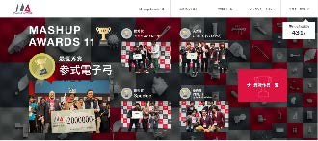
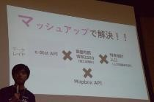
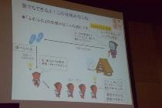
VLED Activities in Fiscal 2015
（MASHUP AWARDS 11）
What is MASHUP AWARDS ?
▶ Contests for website developers to compete in terms of technology, design and ideas of
their sites, smartphone applications, etc.
▶ Started in 2006. The 11th time this year.
■ We Manage CIVICTEC Category Award out of 6 Category Awards.
▶ CIVIC TECH is :
 Activity or Its Technology Used for Solution of Local Issues Making Use of ICT.
▶ We commend innovative applications and/or services that are used for solution of local issues
making use of open data provided by local authorities.
▶ Open Data Award : Sppada – for Diagnosing Issues of All Regions of Japan
▶ Open Data Partner Award : Fumufumu

Slide 28

PART 3
Association for Open Data
iii, The University of Tokyo
of Public Transportation

Slide 29
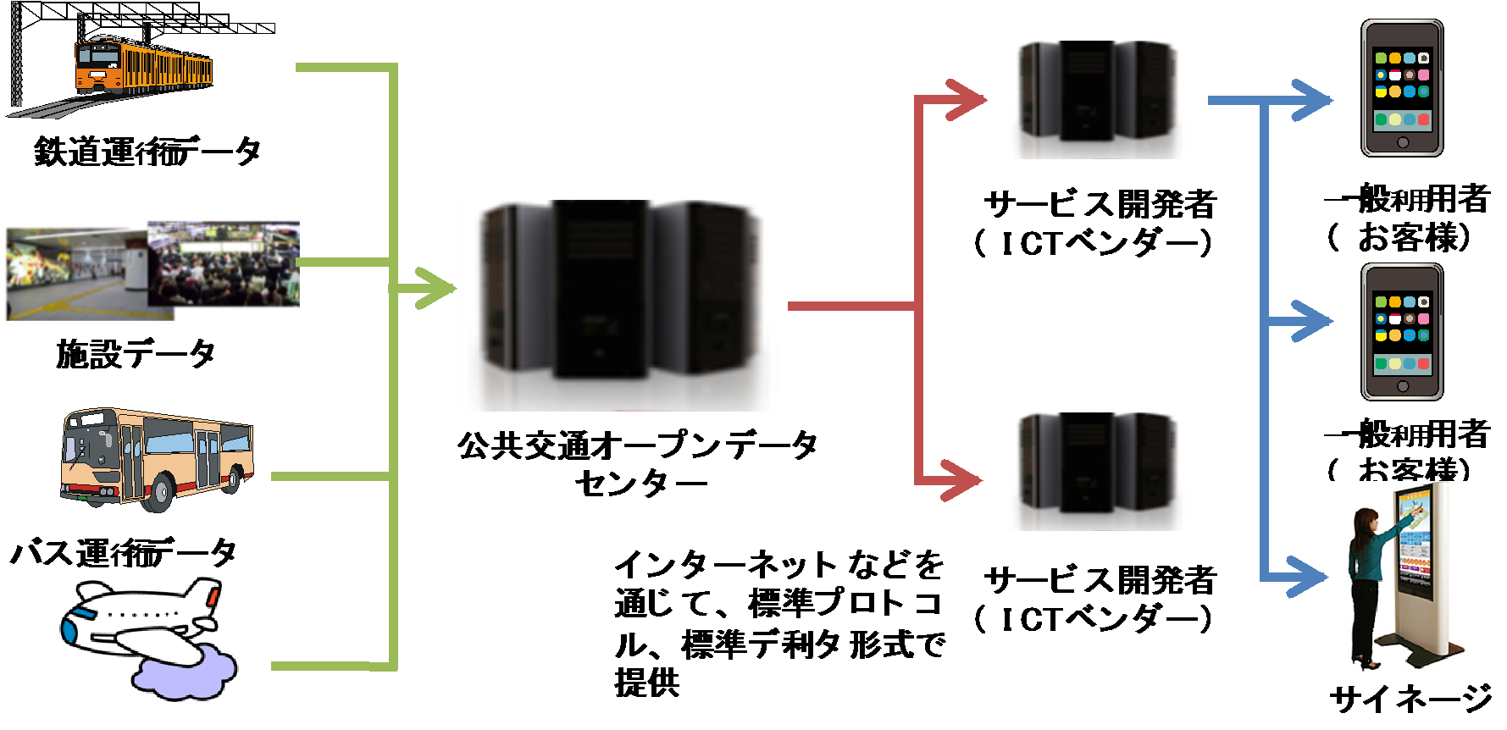
Purpose of Association for Open Data of Public Transportation
■ “Association for Open Data of Public Transportation” aims at developing advanced next generation public transportation information services, making research on its standard platform, and proposing public transportation policies. This is to be done by further advancing the research results made by its predecessor, Council for Open Data of Public Transportation, and by fully utilizing “open data” concerning public transportation.
■ The Association will provide open-data-based information services useful for the provision of smooth public transportation for the 2020 Tokyo Olympics and Paralympics.

Slide 30
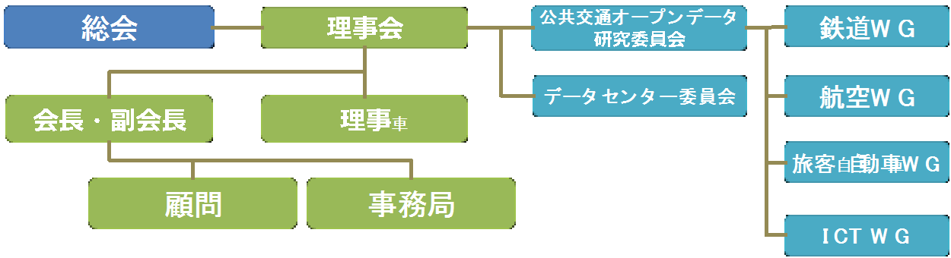
Setup (as of Nov. 2015)
■ Chairman
▶ Ken Sakamura （Professor, the University
of Tokyo）
■ Advisor
■ Members
▶ WingArc1st Inc.
▶ Val Laboratory Corporation
▶ Odakyu Electric Railway Co., Ltd
▶ Kanto Bus Co., Ltd.
▶ Google Co.
▶ Keio Corporation
▶ Keisei Electric Railway Co., Ltd.
▶ Keikyu Corporation
▶ Jorudan Co., Ltd.
▶ Seibu Railway Co., Ltd.
▶ All Nippon Airways Co., Ltd.
▶ Sony Corporation
▶ Dai Nippon Printing Co., Ltd.
▶ Tokyu Corporation
▶ Tokyo International Air Terminal Corporation
▶ The University of Tokyo, Interfaculty Initiative in
Information Studies
▶ Tokyo Metropolitan Government, Bureau of
Transportation
▶ Tokyo Metropolitan Television Broadcasting
Corporation
▶ Tokyo Waterfront Area Rapid Transit, Inc.
▶ TOBU Railway Co., Ltd.
▶ TOBU BUS CO., LTD.
▶ NARITA INTERNATIONAL AIRPORT
CORPORATION
▶ Japan Airport Terminal Co, Ltd.
▶ Japan Airlines Co., Ltd.
▶ NTT Corporation
▶ PASCO CORPORATION
▶ Hitachi, Ltd.
▶ National Defense Academy of Japan
▶ Tokyo Waterfront New Transit YURIKAMOME
▶ YRP Ubiquitous Networking Laboratory
▶ Takashi Itsumi (Chief Engineer, Tokyo Met. Gov.)
▶ Tetsuya Nishikura (Chief Engineer, Tokyo Met. Gov.)
▶ a few people (requesting)
■ Board Member Companies
▶ Tokyo Metro Co., Ltd.
▶ NEC Corporation
▶ East Japan Railway Company
▶ FUJITSU LIMITED
■ Advanced ICT Partner
▶ Microsoft Japan Co., Ltd.
■ Observer
▶ Ministry of Internal Affairs and
Communications
▶ Ministry of Land, Infrastructure, Transport &
Tourism
▶ Tokyo Metropolitan Government

Slide 31
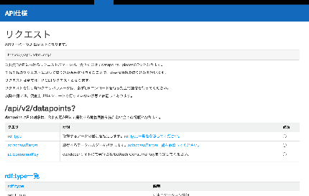
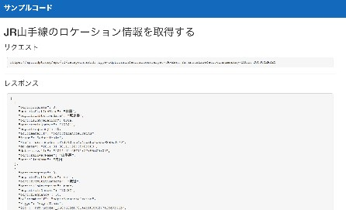
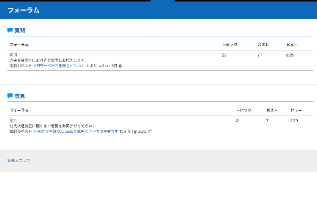
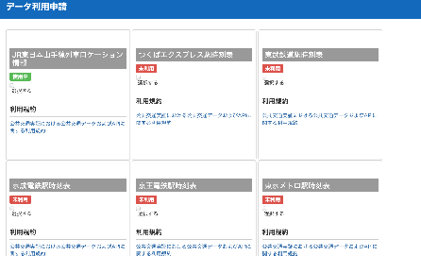
Activities : Open Data Developers’ Websites
API Specification
Sample Codes
Forum (Information Exchange among Developers)
Data Catalogue

Slide 32
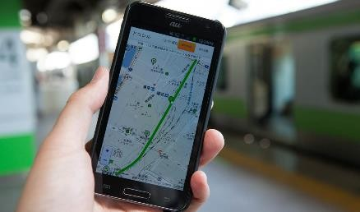
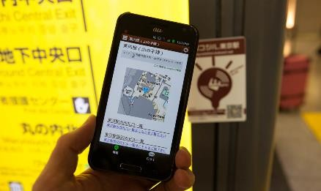
Activities : Information Provision Service for Passengers
(Dokoshiru, Kokoshiru)
■ Real-Time Operation Information Service “Dokoshiru”
▶ Provision of Information on Real-Time Operation and Time-Tables of Railways and Buses
▶Provision of Information on Real-Time On-Rail Trains and Bus Locations as well as Their Time-Tables
■ Smart Terminal Information Service
“Kokoshiru”
▶Information Provision on Public Transportation Facilities including Stations and Airports
▶Real-Time Information Provision on Congestion Situations at Transport Facilities
▶Provision of In-Facility Guidance in Response to the Users’ Position Information
▶ Information Provision Experiment will be Made upon Installation of Kokoshiru Markers with Bluetooth LE in Transport Facilities such as Stations and Airports.

Slide 33
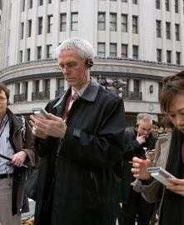

Activities : Multilingual Public Transportation Information Provision
■ Multilingual Information Provision making use of Machine Translation System
■Consolidation of Information in Dictionaries and Corpuses for Provision of Public Transportation Information
■ Description in Parallel in Japanese Kana Notation and Roman Characters for
Proper Nouns such as Station Names

Slide 34
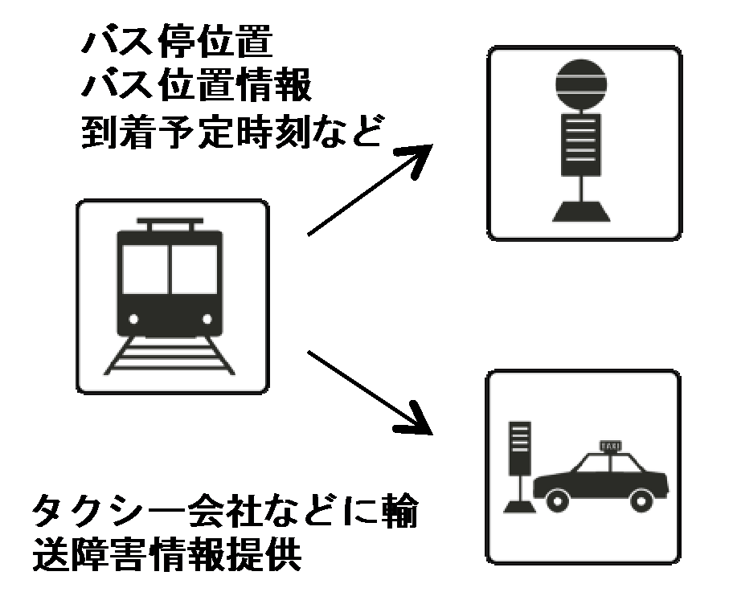
Activities : Information Provision at the Time of Transport Disorder
■ Guidance Provision regarding Alternative
Transport Means
▶In case of disorder in railway line, advice
should be given to take alternative transport
means including buses and taxies.
▶ Guidance Provision on Alternative
Means at the Time of Flight Cancellation.
▶ Provision of A Set of Information including
Bus Location, Real-Time Position of
Railways, etc. Intended to Urge Passengers
to Take Alternative Transport Means.
■ Information Exchange among Transport
Operators

Slide 35
Tokyo Metro Open Data Contest
iii, The University of Tokyo

Slide 36
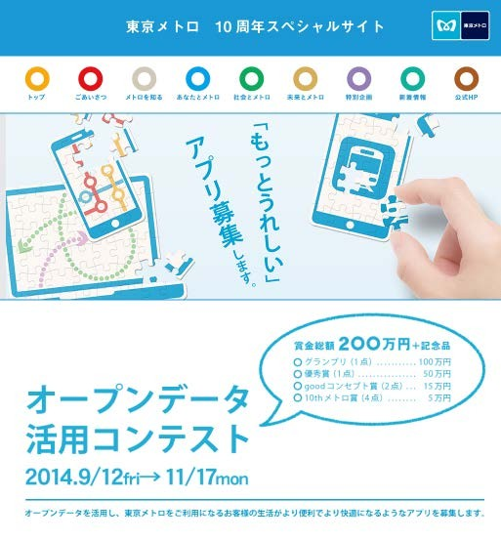
Tokyo Metro Co. Ltd., Open Data Contest Now

Slide 37
Open Data Provided at the Contest
■ Provision of Data on Train Position, Time of Delay, etc. of All Tokyo
Metro Lines
※ Data to be Renewed and Delivered Every Minute
▶ Direction (Where to Go)
▶ Train Number
▶ Train Type (Local, Limited Express, Express, Rapid Service, Extra)
※ Non-Operational Train (Trial Run, Out-of-Service) is not dealt in Open Data.
▶ Starting Station / Destination Station
▶ Owner of Train (Which Railway Servicer Owns the Train?)
▶ On-Rail Position of the Train (at a Specific Station or in between 2 Stations)
▶ Time of Delay (“Delay” is displayed in case of delay of more than 5 min.)
■ Provision of Other Varied Data on Train and Facilities
 Time Table by Station, Fare Table, Required Time between Stations, Boarding-Alighting
Number of Passengers by Station, Location of Women-Only Cars
▶ Information of Facilities
 Barrier Free, Entrance/Exit of Stations, Facilities of Railway Cars, Entrance/Exit of Cars

Slide 38
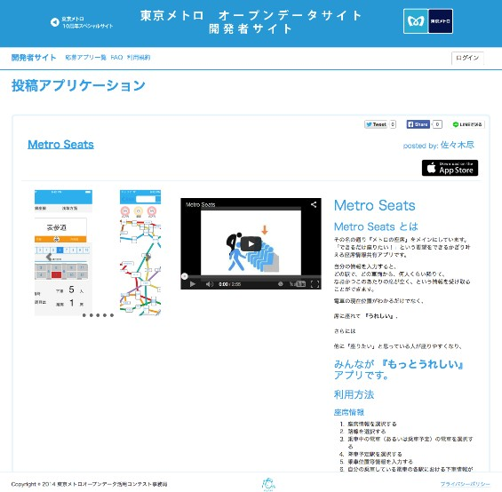
Number of Works Sent to the App. Contest = 281

Slide 39
iii, The University of Tokyo
According to the Case of Tokyo Metro App. Contest Only
ROI = Approx. 1 Billion Yen
(Only the Effect in the Early Stage of Development )
300 Pieces of App. Equivalent to 3 Million Yen Each
Value of Data of Other Companies is Much Higher

Slide 40
Future Activities
iii, The University of Tokyo

Slide 41

Activity Target in the Fiscal 2015
Establishment of
Public Transportation Open Data Center

Slide 42
PART 5
Reference Information
iii, The University of Tokyo

Slide 43




Tokyo Midtown Hall
Midtown East B1F
2015/12/09 (Wed) ～ 11 (Fri)
43

Slide 44
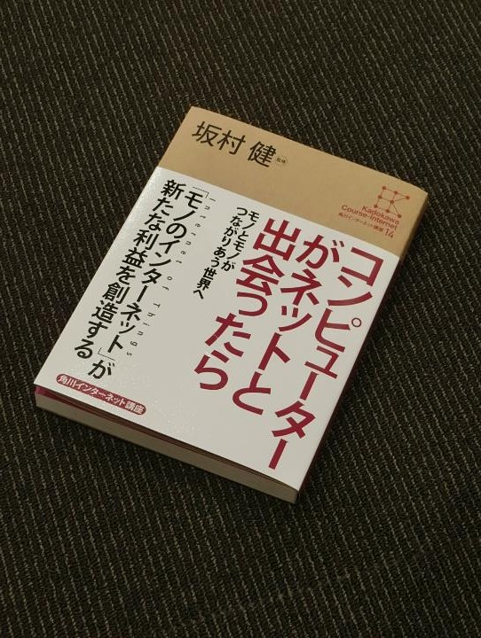
www.tron.org

