Slide 1

Open Mind, Open Knowledge, Open Society
/ Masahiko Shoji / CC-BY 4.0
Open Knowledge Japan
Hiroichi Kawashima （hiroichi.kawashima@gmail.com）
Diagram:Ukiyoe Print by Yoshiiku Ochiai “Contemporary Four Devas”

Slide 2






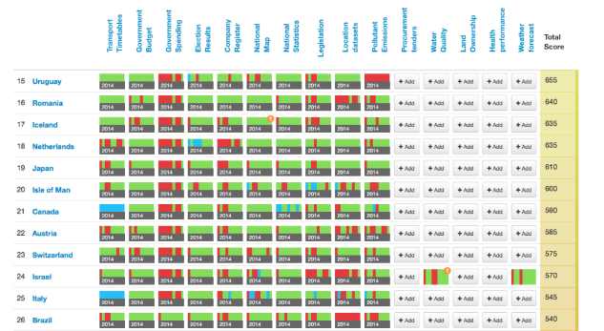

Organization
Established in UK in July 2004
President, Co-Founder
Dr Rufus Pollock
CEO
Pavel Richter
Definition
Working Groups / Projects
Open Data Index
Global Network
Chapter 9 Countries Initiative 49 Countries

Slide 3



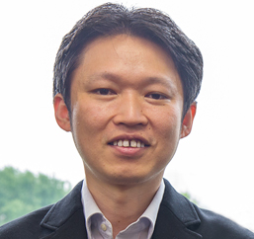
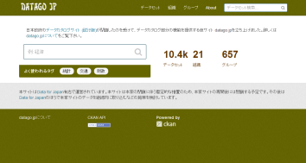
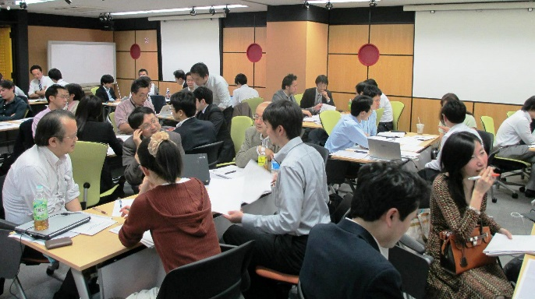
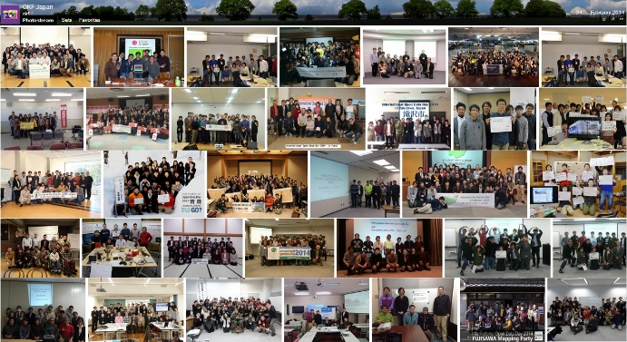
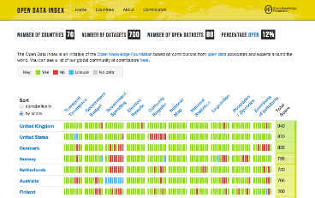



Organization
Established in July 2012
Vice-President Koichi Kawashima
Vice-President Tomoaki Watanabe
President
Masahiko Shouji
Providing Community Formation Information & Promoting Emergence
Policy Proposals & Assistance
International Open Data Day in Japan
http://okfn.jp/
@OKFJ
https://www.facebook.com/OKFjp

Slide 4
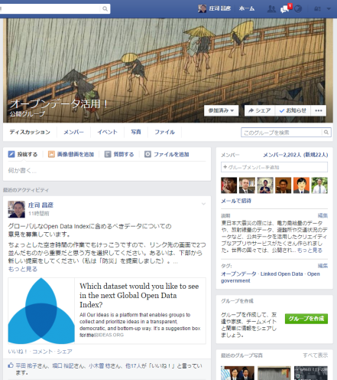
Organization
＜Corporate Members＞
IBM Japan Inc.
Georepublic Japan
Academic Resource GuideInc
iPublishing ESRI Japan,Inc.
ASKOE Partners,Inc
Yahoo Japan
Double Standard Inc.
＜Personal Members＞
Approximately 30 Persons
Institute for Public Innovation
＜Facebook Group＞
”Utilize Open Data！”2382persons
Intage Inc.

Slide 5
Data / Policy / International
Policy

Slide 6
方針
“Forget Big Data,
Small Data is the Real Revolution“
  Rufus Pollock (Open Knowledge Foundation)
  The Guardian Data Blog 2013.04.25

Slide 7
Open Data Talk
Activities
Dig Deep into Data Disclosure Needs
Share Information on the latest trends in Open Data and Exchange Views
Read “Guidelines on Open Government Data for Citizen Participation”
Present Ideas for “Contest for Big Data/Open Data Utilization Ideas
Politics/Elections/Parliament and Open Data
The Latest Trends of Open Data in the World
Summit for Those Responsible for Open Data in Local Governments
Open Data Day Pre-Event
Reflections on Open Data Day and Future Perspectives
Report On OK Festival Participation and Recent Topics
Open Data of Public Libraries and Museums,etc. and Open Data Census
Mokumoku Group Tackling with Open Data Census
International Open Data Day Pre-Event & Year-End Party！
The Second Step of International Open Data Day Pre-Event
なぜ、Why Has Care × Open Data High Tec Business WELMO ,Inc. Started Business in Fukuoka？
Finally It Has Come into Being！ 〜Full-Fledged and Japan-Originating Analytics Business Utilizing Open Data （2015/12/15)

Slide 8
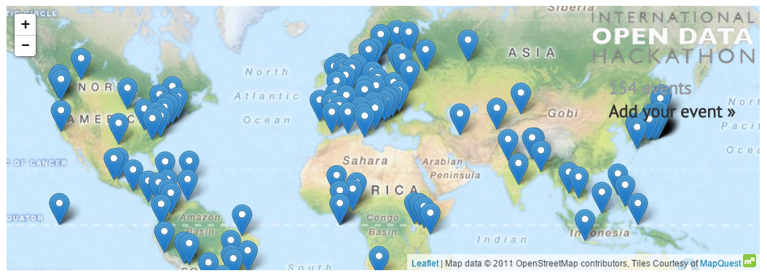


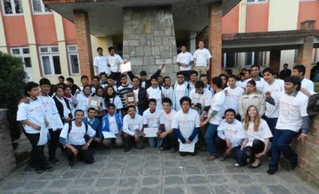

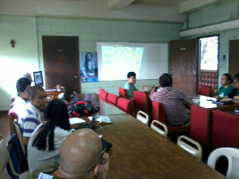
International Open Data Day
Activities
Organize Concurrently Events throughout the World Supporting Open Data policies in Central & Local Governments in the World and Promoting the Use of Open Data Available for Every body
Engineers, Analysts, Officials and citizens, etc. Interested in Data Utilization and Regional Problem Solutions Get Together

Slide 9

Activities
2013 Organized in 102 Cities in the World、in 8 Ciities in Japan(Third in the World in the Number of Cities in One Country)
2014 Organized in 194 Cities in the World、in 32 Cities in Japan(Second in the World in the Number of Cities in One Country)
2015 Organized in 222 Cities in the World, in 62 Cities in Japan(the Largest Number of Cities in One Country)
2016 Organized in ?? Cities In the World ,in ?? Cities in Japan
OKF Japan Flickrページより

Slide 10
International
Open Data Day 2016
活動
Organized Saturday March 5 2016！

Slide 11
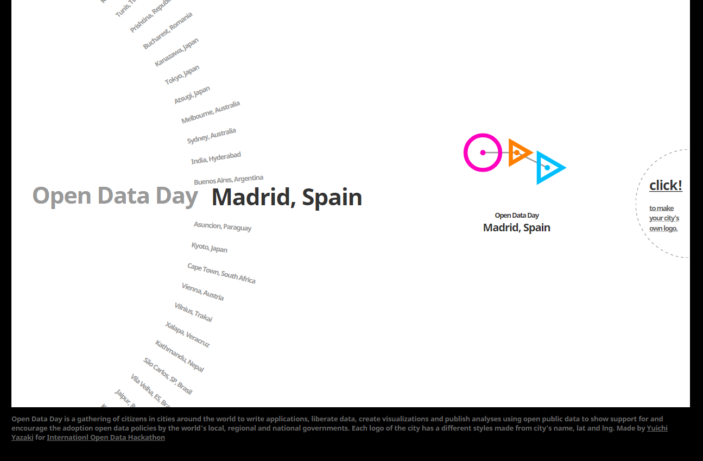
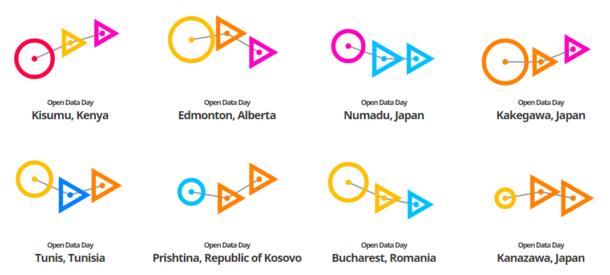
Open Data Day Logo Generator
Made by Yuichi Yazaki

Slide 12
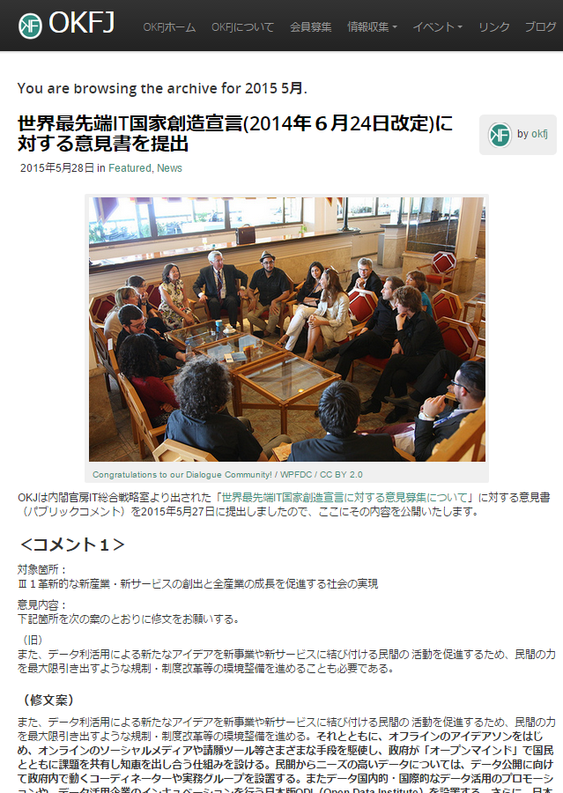
Policy Proposal
Activities
Submitting Opinion Paper on Declaration of the World Most Advanced IT State Creation (Revised June 26,2014)
（Part）
To Aim at the Level of the Most Advanced in the World, Japan should participate actively in these Index-Making Efforts, Expand the Number of Countries and Regions for Cooperation, take the Initiative in Rule-Making, Otherwise the Standard of the Most Advanced will Change. Therefore, instead of Trying Passively to Catch up within the Given Rules, Requested to Participate Actively in Discussions for International Index –Making and to Play a Leading Role in the Making of International Index as International Public Goods and Specific Assessment Activities

Slide 13
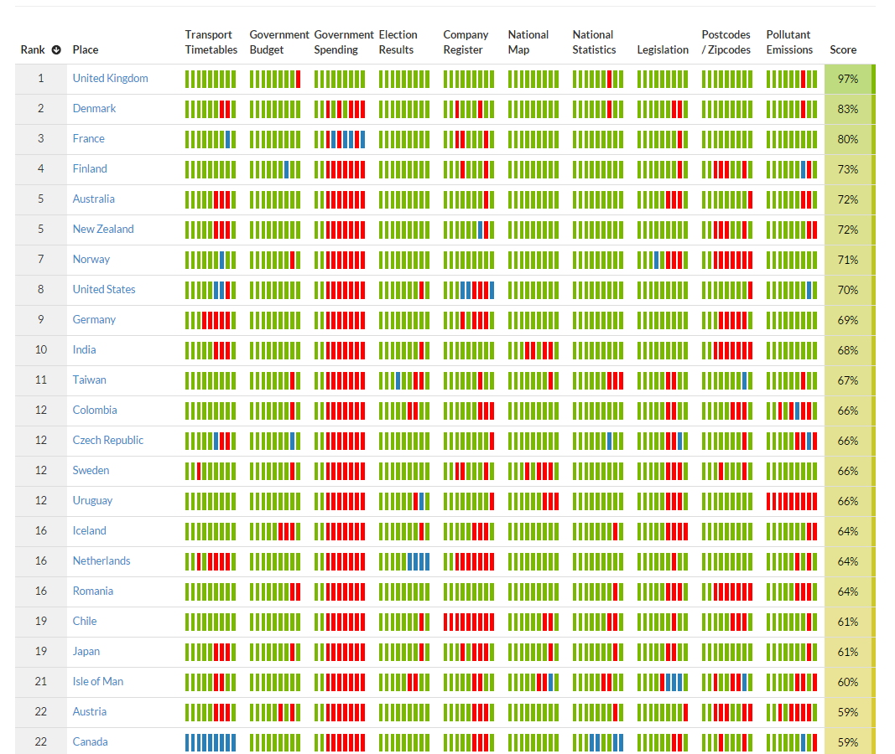
Though Up in Ranking, Agenda remains for Japan to Further Data Opening
Open Data Index 2014
Activities
Local Government Assessment will Start This Year！
Japan
Up from the 27th in 2013 to the 19th in 2014
Agendas to be addressed
－Timetable
出Government Expenditures
－Business Registration
－Increased Open Licensing
Japan 19th
Open data Index 2014 by Open Knowledge

Slide 14

Proposal of “ Open Data 500 in ASIA“
Activities
Open Data 100 in Japan
+
Open Data 100 in XXXX
+
Open Data 50 in XXXX
+
Open Data 50 in XXXX
+
Open Data 20 in XXXX
+
Open Data 20 in XXXX
in ASIA
The Open Data 500, The GovLab, CC BY-SA 4.0

Slide 15
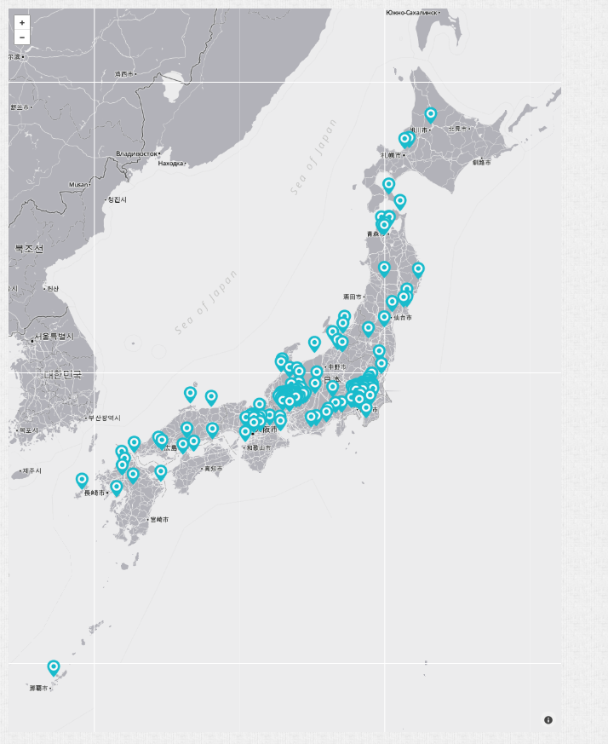
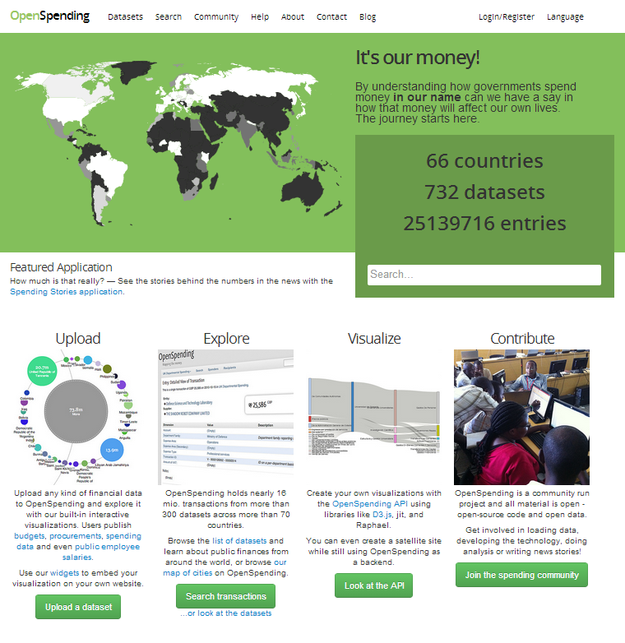
Taxes! Where are they Gone? / OpenSpending
Activities(Assistance)
spending.jp
those Covering 170 Local governments In Japan have been Established
OpenSpending
401 Data Set of 1084 (37%)are from Japan

Slide 16
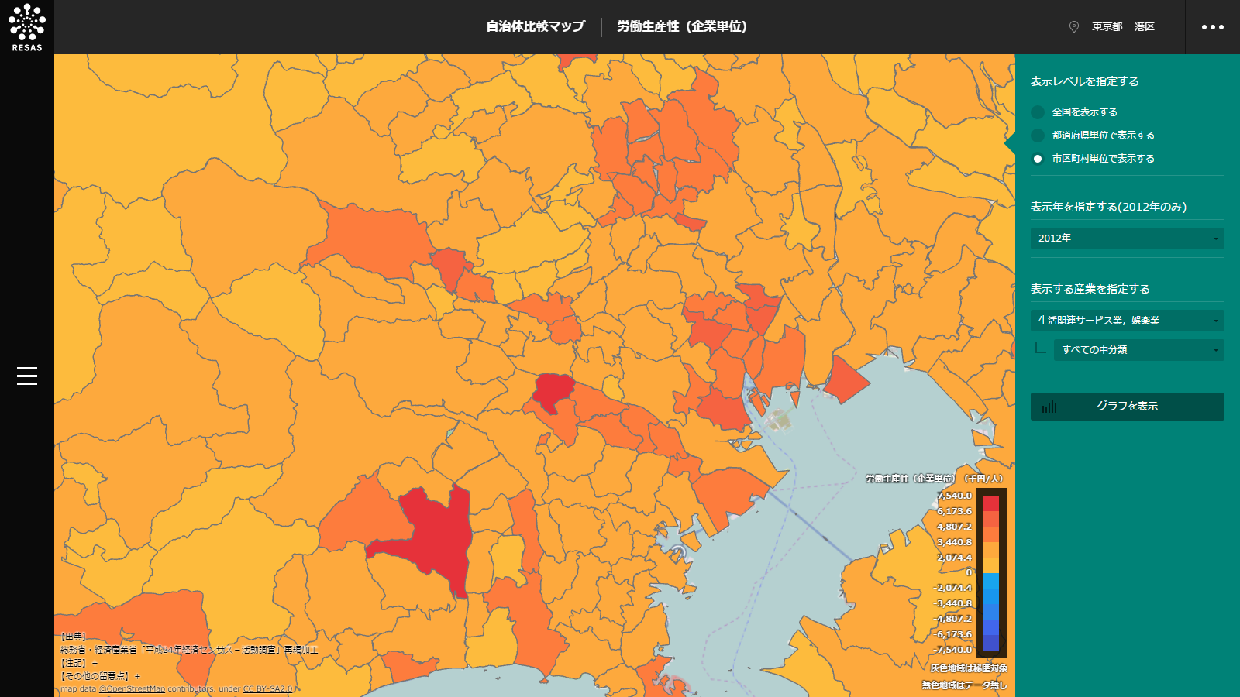
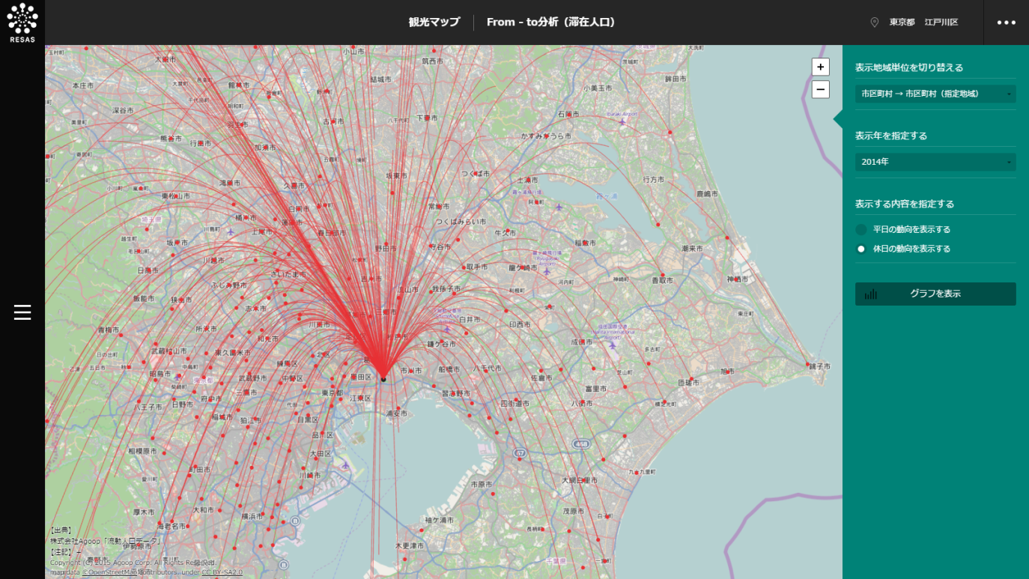
RESAS（Regional Economy Analysis System）
Proposal
Various Public& Private Sector Data utilized
Can be Utilized under Certain Conditions for Reproduction, Public Broadcasting, Adaptation ,etc. such as Translation and Transformation
OpenStreetMap used
https://resas.go.jp/

Slide 17

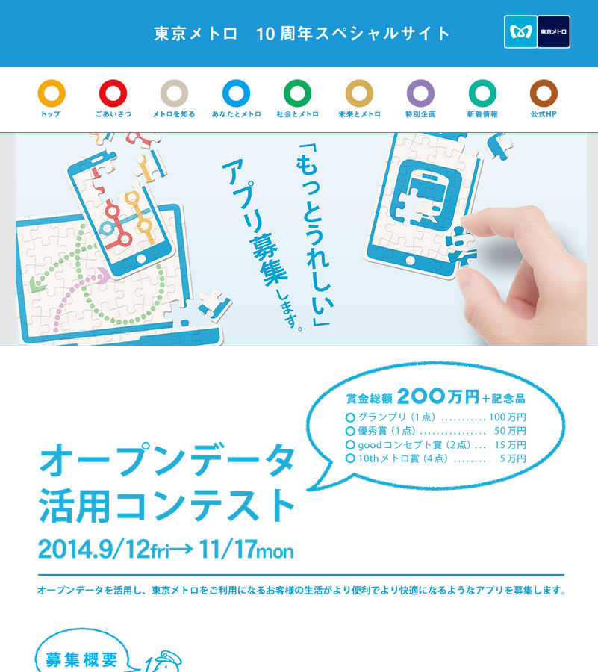
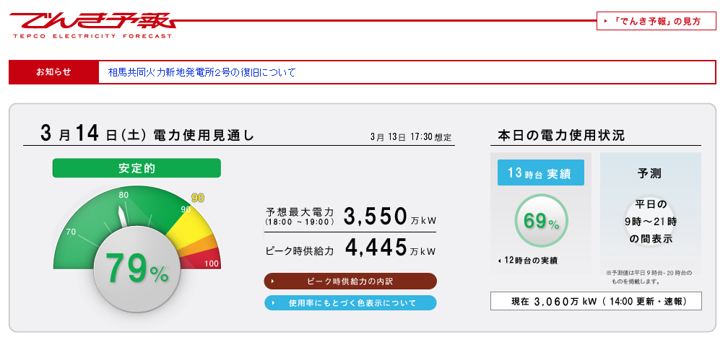
Open Data by Businesses
Proposal
出典：東急電鉄
Sources: Tokyo Electric Power Co., Ltd.
Sources: Tokyo Metro

Slide 18
Proposals
Open Mind,
Open Knowledge,
Open Society

