Slide 1
Open Data Symposium2015
Introducing Open Corporates Japan
November 25,2015
Open Corporates Japan(General Incorporated Association) Tomihiko Azuma
tomi@opencorporates.jp

Slide 2
Objectives
1) Research & Study on Open data
2) Planning & Management of Information Disclosure Platform
3) Activities related to the Regional Diffusion of Open Data
4) Policy Proposal & Advise for Open Data Development
5) Cooperative Activities with Related Organizations to Promote Open Data Development
6) Promoting Public Relations & Cooperative Activities with Related Organizations as the Window Organization Representing Open Corporates in Japan

Slide 3
Organization
Representative Director Hiroshi Nakajima (President of MMRI,Inc . , Professor of International University of Japan Global Communication Centre
Managing Director Tomihiko Azuma (President of Publica Co.Ltd. , Seniro Researcher of International University of Japan Global Communication Centre)
Director Hiroaki Fujii (President of ANALYSTA Co.Ltd.)
Director Noriaki SAYA (President & CEO of PIPED BITS Co.Ltd.)
Director Hideaki Takeda (Professor of National Institute of Informatics, President of Linked Open Data Initiative(general incorporated association))
Director Hideyuki Yasui (President of Asukoba Partners Inc. , Representative Director of Universal Menu Association (general incorporated association))
Auditor Masami Honda (Visiting Researcher of Graduate School of University Tokyo)
Advisor Yuichi Okumura (Visiting Professor of Graduate School of Public Policy of University of Tokyo)
Advisor Kouichi Kawashima (Professor of Graduate School of University of Tsukuba)
Advisor Masahiko Shouji (Senior Researcher /Associate Professor of International University of Japan Global Communication Centre, Representative Director of Open knowledge Foundation of Japan)

Slide 4
Business Contents
1) My Kohoshi(My Public Relations Magazine)
• Service to Collect Public Relations Magazine Data of Local Governments, etc. and Distribute Free of Charge on the Internet ( https://mykoho.jp/ )
• Aiming to Serve as Platform to Support Local Governments’ Public Relations Activities
2) Invasive Alien Species Discovery Solution “Jamazon"
• Atsugi City Published Magazine “Chat Map Atsugi Invasive Alien Species Survey Team”( https://chatmap.jp/gairai/ )
• Coverage Extended to Crisis Management, Graffiti, Illegal Waste Dumping, etc.
3) Catalogue Portal Covering Open Data of Nationwide Local Governments
• Original Portal Site Collecting Open Data of Nationwide 134 Local Governments Developed, which Enables One-Stop Access to approximately 60 thousands Data (For further detail, access to info@opencorporates.jp )

Slide 5
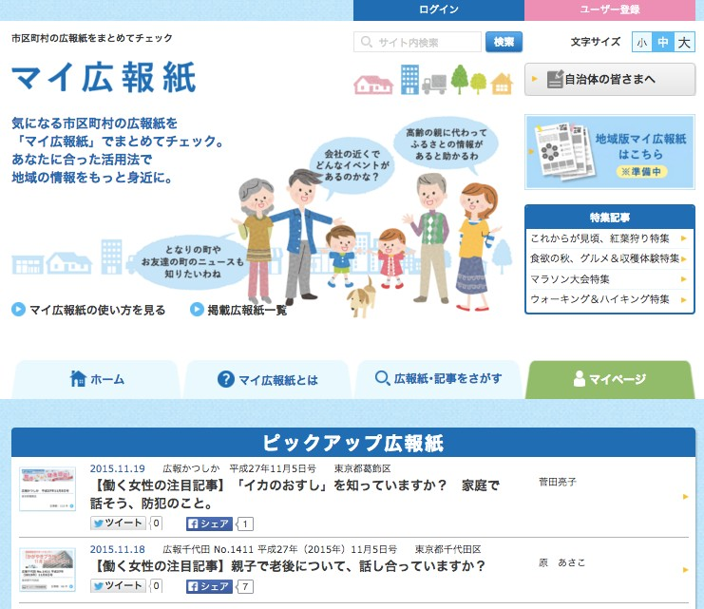
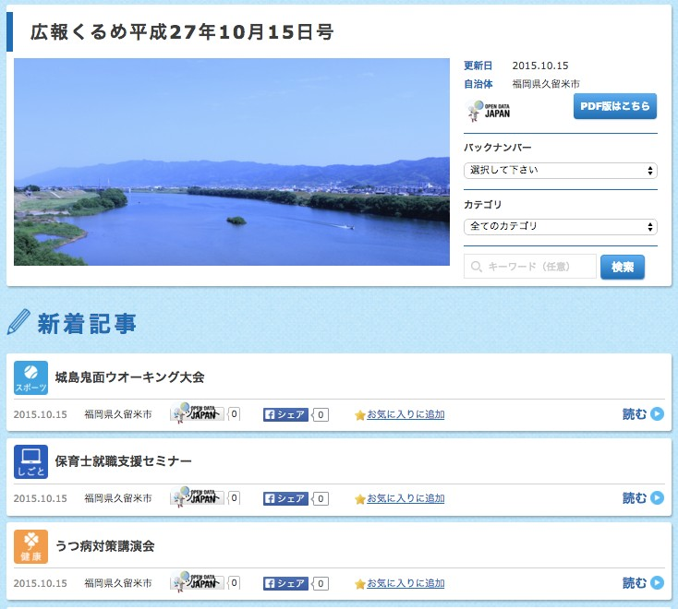
My Public Relations Magazine(My Kohoshi)
https://mykoho.jp/

Slide 6
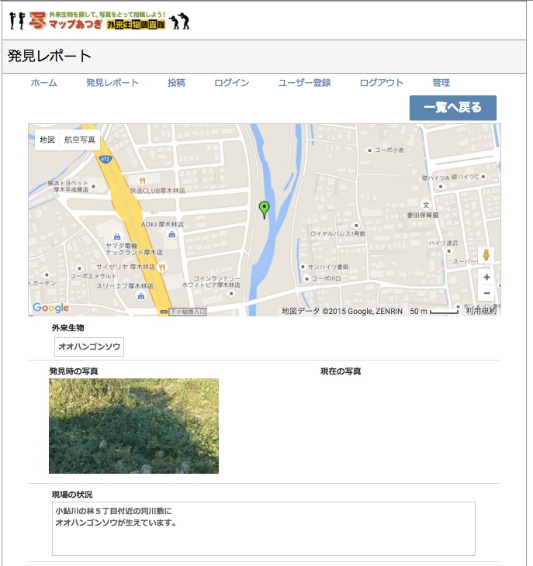
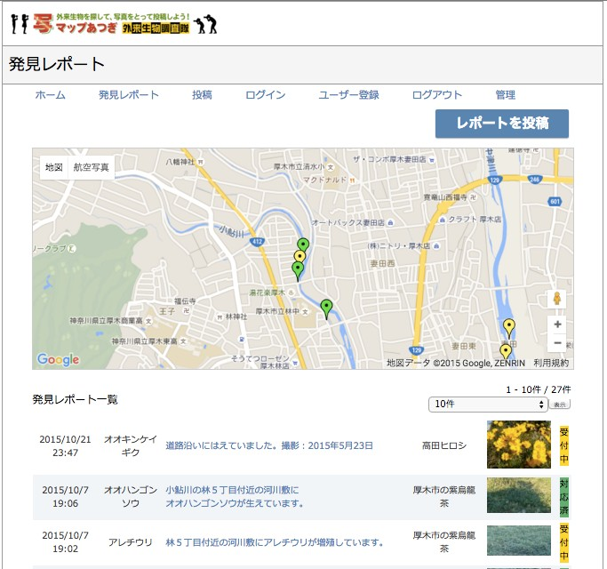
Chat Map Atsugi Invasive Species Survey Team
https://chatmap.jp/gairai/

Slide 7
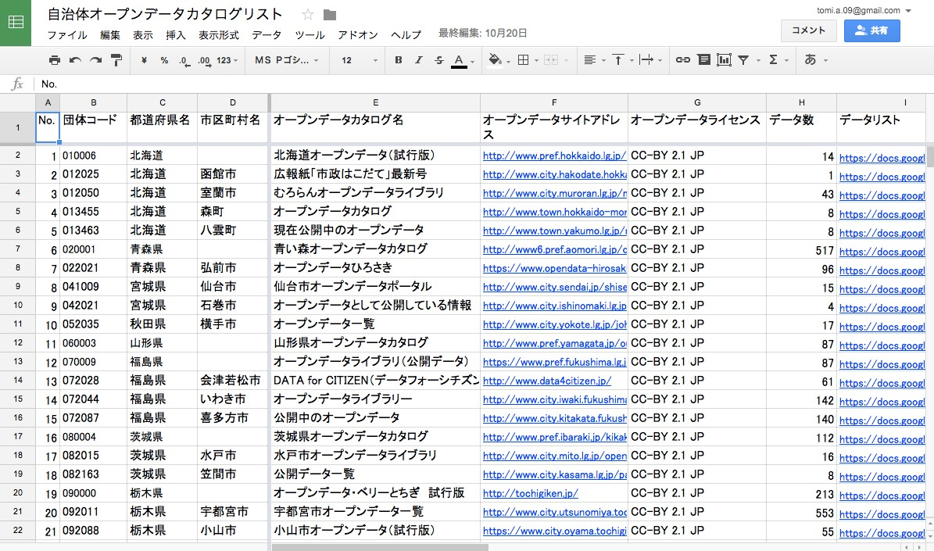
Nationwide Local Governments Open Data Catalogue Portal

Slide 8

http://www.opencorporates.jp/ info@opencorporates.jp

