Slide 1

Open Data Symposium 2015
“EvaCva”, a Tool to Visualize Regional Characteristics, utilizing Open Data
Tetsuyoshi SHIOTA
Chief Researcher,
Environmental Science & Technology Project,
R&D Strategy and Planning Office,
Fujitsu Laboratories Ltd.

Slide 2
Problems associated with the resolution of and countermeasures against regional issues
Although we try to follow other successful examples, -------
We are never sure if we will succeed, even if we follow successful examples in other municipalities, because characteristics are different from region to region.
It is, therefore, necessary to draw up specific measures corresponding to the characteristics of each region.
Realization of “Evidence-Based Policy”
For that purpose,
It is advisable to extract (identify) municipalities with similar characteristics and use as reference the measures adopted in those municipalities.

Slide 3
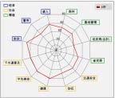
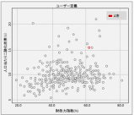


Flow of drawing up Measures based on Data
1. To identify municipalities with similar characteristics that solved issues they set.
1
2
3
4
5
6
Grasping characteristics
Setting issues to solve
Identifying municipalities that can be used as reference
Examining possible measures
Predicting the effects
Deciding upon measures to adopt
Support by use of “EvaCva”
2. To compare with the municipalities with similar characteristics and find issues to solve.
1
2
3
4
5
6
Grasping characteristics
Setting issues to solve
Identifying municipalities that can be used as reference
Examining possible measures
Predicting the effects
Deciding upon measures to adopt

Slide 4
What is “EvaCva”?
EvaCva
Evalutate
+
City Value
“EvaCva” is a tool to visualize regional characteristics, utilizing open data.
“Eva” stands for “Evaluate” and “Cva” for “City Value”. We named this tool as “EvaCva” by putting these two things together, and giving meaning into it to discover the value of each region and revitalize it.

Slide 5

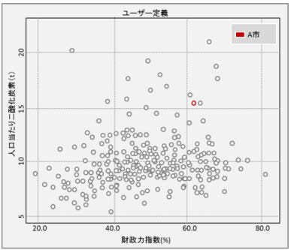
Features of EvaCva
Grasping characteristics of municipalities multilaterally, from the viewpoint of environment, economics and society.
Open Data
Statistical Data of the National Government
Data released by Government Departments, Ministries and Agencies
Data released by Municipalities
Collection, indexing and visualization of data
1) Deviation Radar Chart
3) Extraction of reference municipalities
Strength and weakness of your own municipality can be grasped at a glance.
By overlapping the chart of your own municipality with those of others, you can make a multilateral comparison.
Regional characteristics are similar.
Reference indices are outstanding.
2) Scatter Chart
You can identify other municipalities with outstanding achievements.
You can identify indices with strong correlation.
Municipalities that are suitable to use as reference are outputted in the order of higher priority based on independent evaluation functions.

Slide 6
Indices handled by EvaCva
■ A total of 127 indices (at present) in the fields of environment, economy and society are established based on the needs, out of a total of more than 1,200 different open data items.
 | Category | Evaluation Factors | Major Indices
 | Economy (41 indices) | Financial soundness | Local tax revenue | Financial index | Ratio of net cost of bonds | Collection rate of tax
 |  | Industrial scale | Gross regional product | Added value | Business income | Number of employees
 |  | Personal income | Taxable income | Completely unemployment rate | Price of residential land | Taxable income
 | Society (61 indices) | Social infrastructure | Number of hospitals Sewage system coverage rate | Number of public halls and libraries Area of city parks | Number of homes for elderly people Regional area by usage of land | Number of day- nurseries
 |  | Social services | Number of traffic accidents Consultation fees based on national health insurance | Number of recognized criminal offences Average life expectancy | Number of fire outbreaks Number of general administrative workers | Number of teachers Number of doctors
 |  | Living environment | Living floor space Number of vacant houses | Number of detached houses Number of retail stores | Number of residences by the distance to the nearest facilities Number of households with short commuting time
 |  | Population | Total fertility rate Population by 3 categories of ages | Population trends Number of marriages | Daytime population Number of single-living aged persons | Population density
 |  | Regional vitality | Number of commuters from other areas | Number of new residential construction starts
 | Environment (25 indices) | Environmental resources | Ratio of both forests and fields | Ratio of cultivation- abandoned land | Inhabitable land area
 |  | Environmental quality | River water quality | Air quality
 |  | Environmental load | Amount of CO₂ emissions Amount of final disposal | Amount of discharged waste Amount of emitted chemical substances | Recycling rate of waste

Slide 7
Example of utilizing EvaCva together with RESAS
■ To utilize functions of EvaCva to pick out reference municipalities.
RESAS
EvaCva
It has many detailed indices related to population and economy.
It can use indices on economy, society and environment.
To establish issues specifically related to population and economy.
To establish issues related to economy, society and environment
To choose municipalities to use as reference
To compare population and economy of reference municipalities.
To compare detailed data of reference municipalities
Examination of measures
Co-created workshop
Hearing
Use of support services

Slide 8
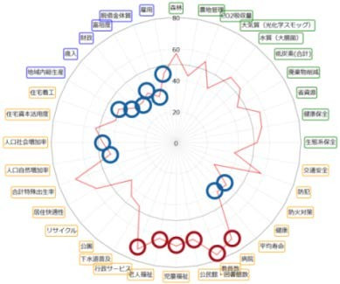
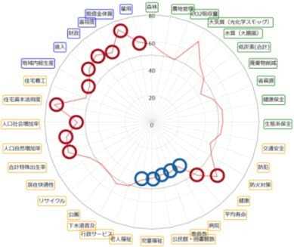



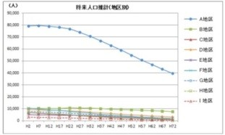
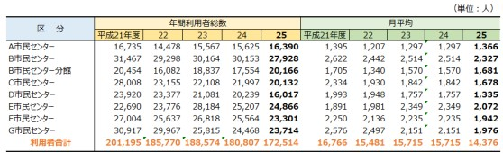





Introduction of “Support Services for Municipalities to Conduct Simplified Evaluation”, utilizing EvaCva
■ By grasping characteristics of each municipality from open data and identifying “Real Issues”, Creation of “Ideas to Resolve the Issues” is supported.
Own City
Other Cities
similar size
in the vicinity
similar environment
possessed of specific measures
possessed of similar measures
etc.
1
Evaluation of the municipality in question by radar chart analysis
comparison
2
Implementation of profound researches by the unit of region and by the length of time period
The direction of issues observed from the radar chart analysis is to be further examined, using various data inherent to the municipality in question.
3
Identification of issues
From the point-at-issue data found in the Web site of City A
4
Establishment of KPI and creation of ideas for measures to resolve issues
From the statistical portal site of City B
Verification of results of measure implementation, and resubmission of a revised proposal
Vis-à-vis identified issues, “Co-creation” is performed, using such methods as interviews and workshops.
5
Implementation of measures
After the creation of ideas, discussions will be held towards actual implementation of measures
Experiment is to be implemented by the municipality.
Copyright 2015 FUJITSU LABORATORIES LTD.

Slide 9




Examples of utilizing EvaCva thus far
■ It is also possible to perform a cross analysis of closed data and open data, which can be utilized for a wide range of applications.
■ It is possible to provide adjusted information customized to individual clients.
<Ministries and Agencies>
Drawing-up of plans
Verification of effects of implementation
Drawing-up of plans
Most suitable display of merchandise
Example of closed data
Sales of shops for individual regions
<Research and Educational Institutions>
<Land Development>
Most suitable utilization of land
Reorganization
(merger/abortion) of facilities
Academic researches
Community-based learning
Example of closed data
Facility utilization factors for individual regions

Slide 10
Business based on EvaCva
■ Provision of added value created from open data
 | Basic Portion (Open to the public) | Added Value Portion (Onerous)
Major function | Radar chart Scatter chart Ranking | Uploading and downloading of index data Identification of similar municipalities and reference municipalities
Index | Open Data (Index to show the outline) | Processed open data (Index capable of making a profound research of characteristics)

Slide 11
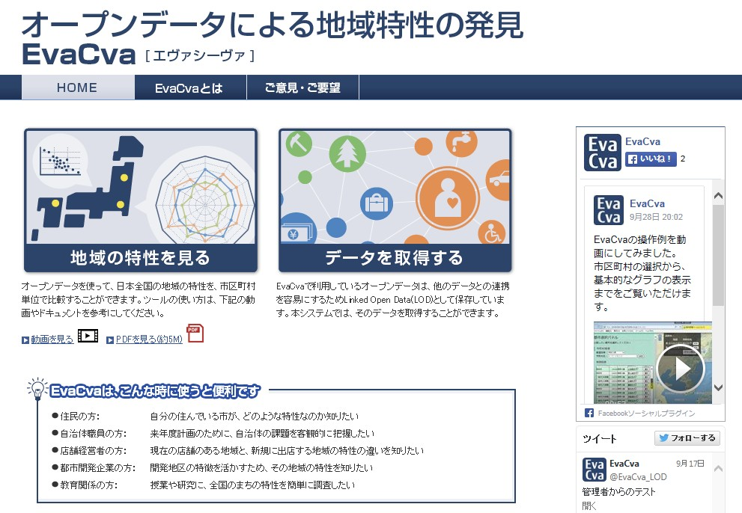
http://evacva.net/
Introduction of a Web site open to the public
EvaCva
IE9 or more and “Chrome” recommended
search
Discovery of regional characteristics by open data
ここを
クリック
操作説明動画
This site is ranked in the 6th place in terms of popularity among ” Yahoo! Category “Open Data sites”

