Slide 1

Agenda for Open Data Use
Agenda for Open Data UseAa
November 25,2015
Haruyuki Seki, Reresentative Director

Slide 2
What is Code for Japan ？

Slide 3

Governments
Sustaining Cooperative Links with Various Organizations
Citizens’ Solidarity
NPO
Businesses
Conceive & Materialize a Creative Idea

Slide 4

































33+21

Slide 5
Put one’s Head Together on Agenda & Work out a Solution
C
Co-Creation Workshop
Local Governments
Citizens
Engineers
Businesses
NPO

Slide 6


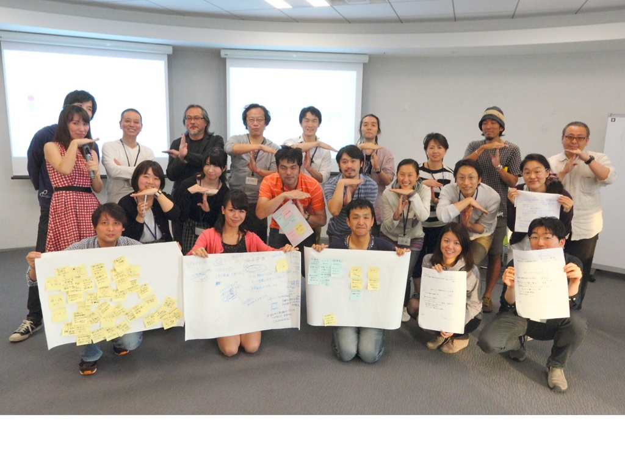
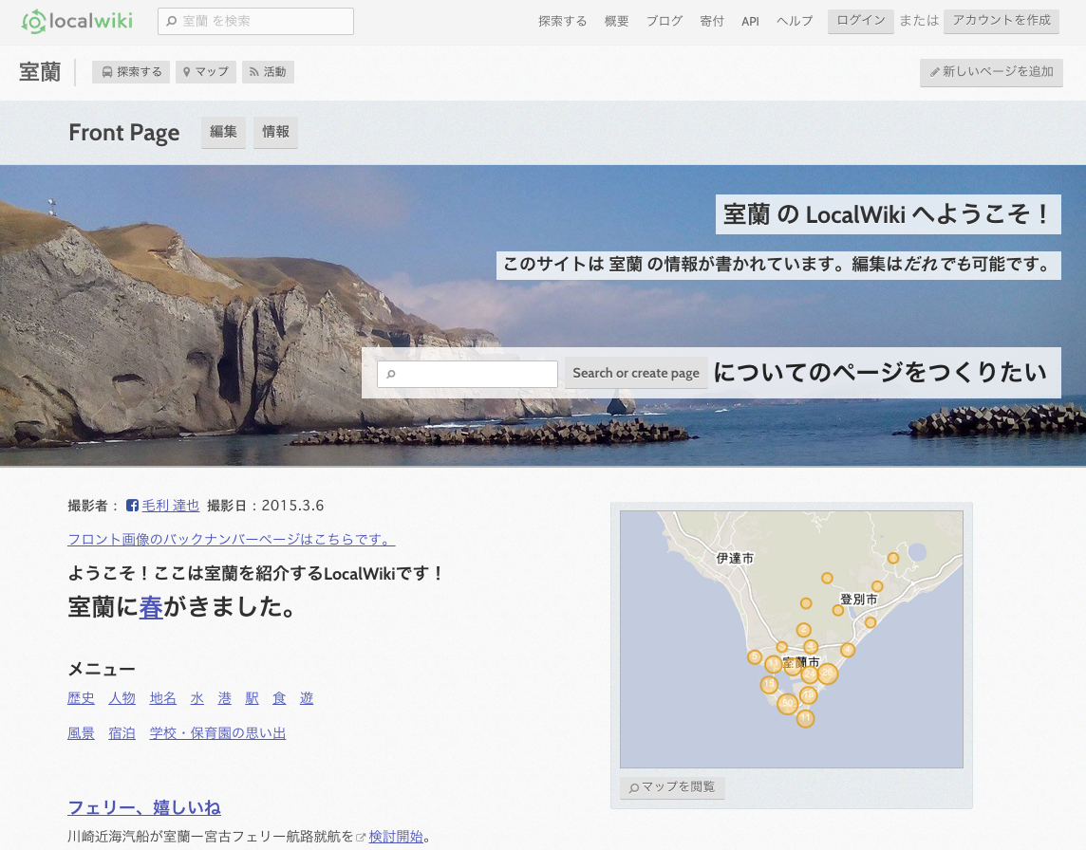
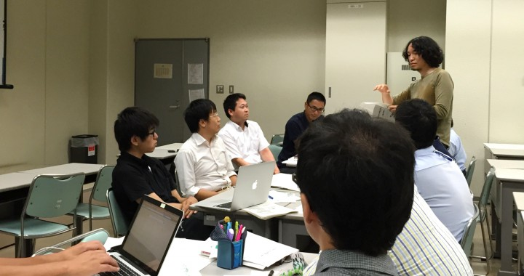
Co-Creation Workshops being Organized in Various Regions！
Let us discover the agendas & Charms of Tokyo for the Olympic Games
(Code for Tokyo)
Public Transport Ideathon/Hackathon
(Code for Nanto)
Child Care App Idea Workshop
(Code for Ikoma)
Open Café Meeting for Discussing on Town Agendas with NPO & Local Government
Mapping Party for Town Walking & Information Collection

Slide 7
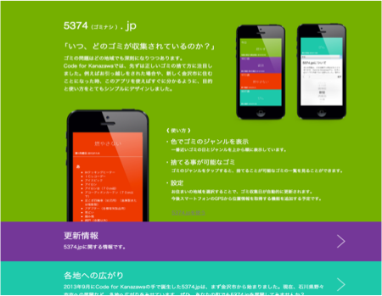
New Tools, etc. originating from the Community
5374.jp to let you Know easily garbageTake-Out
(Code for Kanazawa)

Slide 8
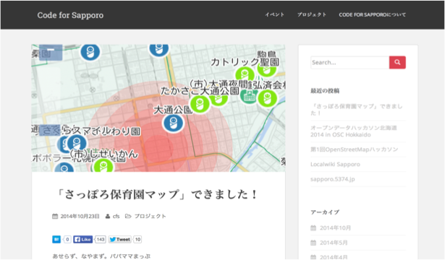
New Tools,etc. Originating from the Community
Sapporo Nursery School Map for Locating Nursery schools on the Map

Slide 9
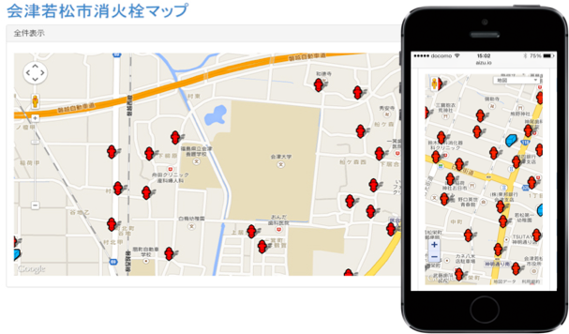
New Tools, etc. originating from Community
Fire Hydrant Map to Help Firemen Locate Fire Hydrants

Slide 10
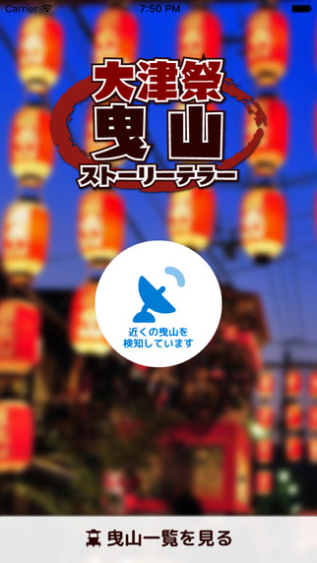
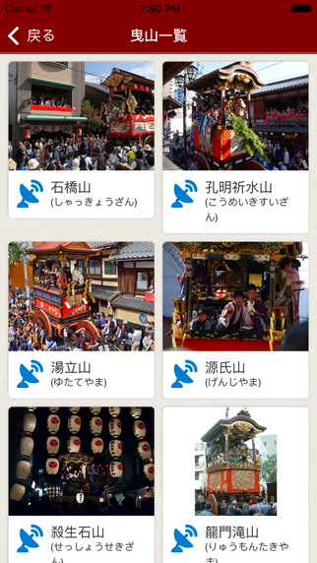
New Tools, etc. Originating from the Community
App to let you Know the Real-time Location of the Festival Float during the Otsu by Code for Shiga/Biwako

Slide 11
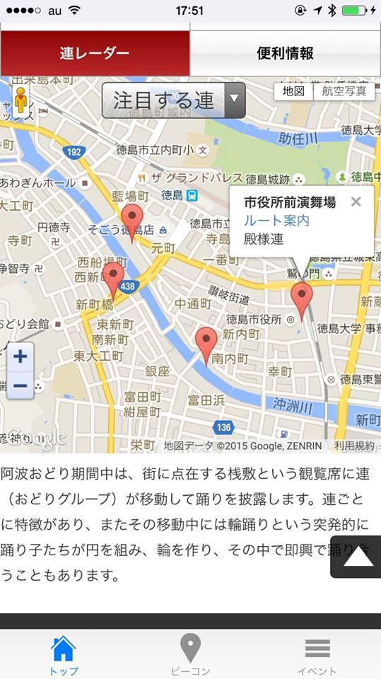
New Community Originating Tools, etc.
Service to let You Know the Whereabouts of Each Dancing Team on Awaodori Festival
by Code for Tokushima

Slide 12
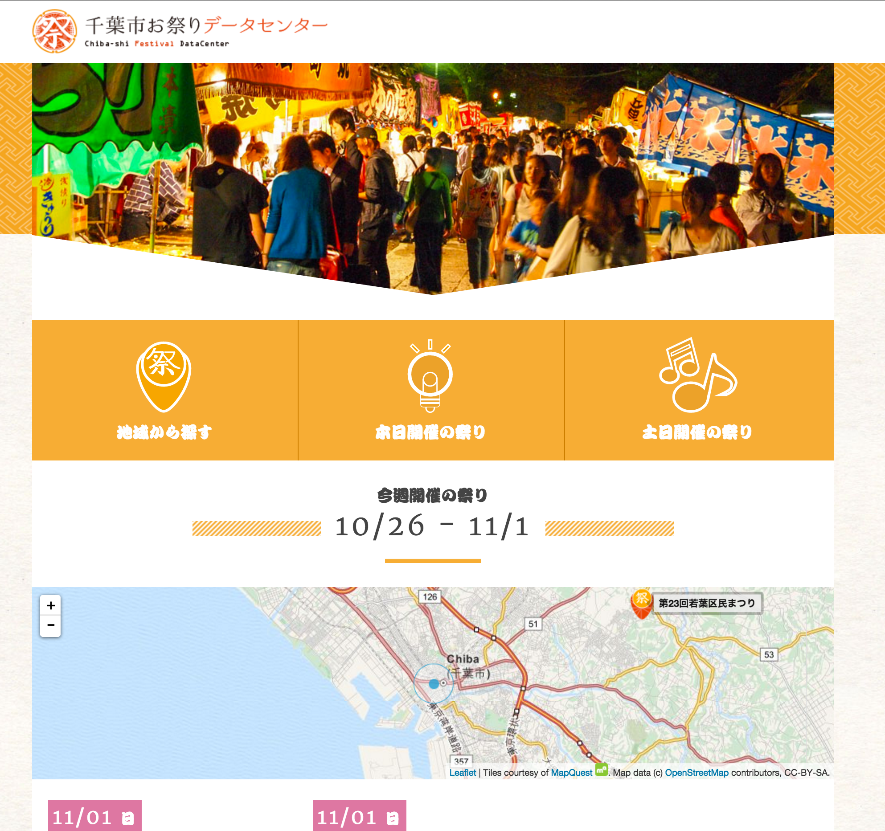
New Tools, etc. Originating from the Community
Service to Let You Know the Location & Timing of Festivals celebrated within the City
Code for Chiba

Slide 13
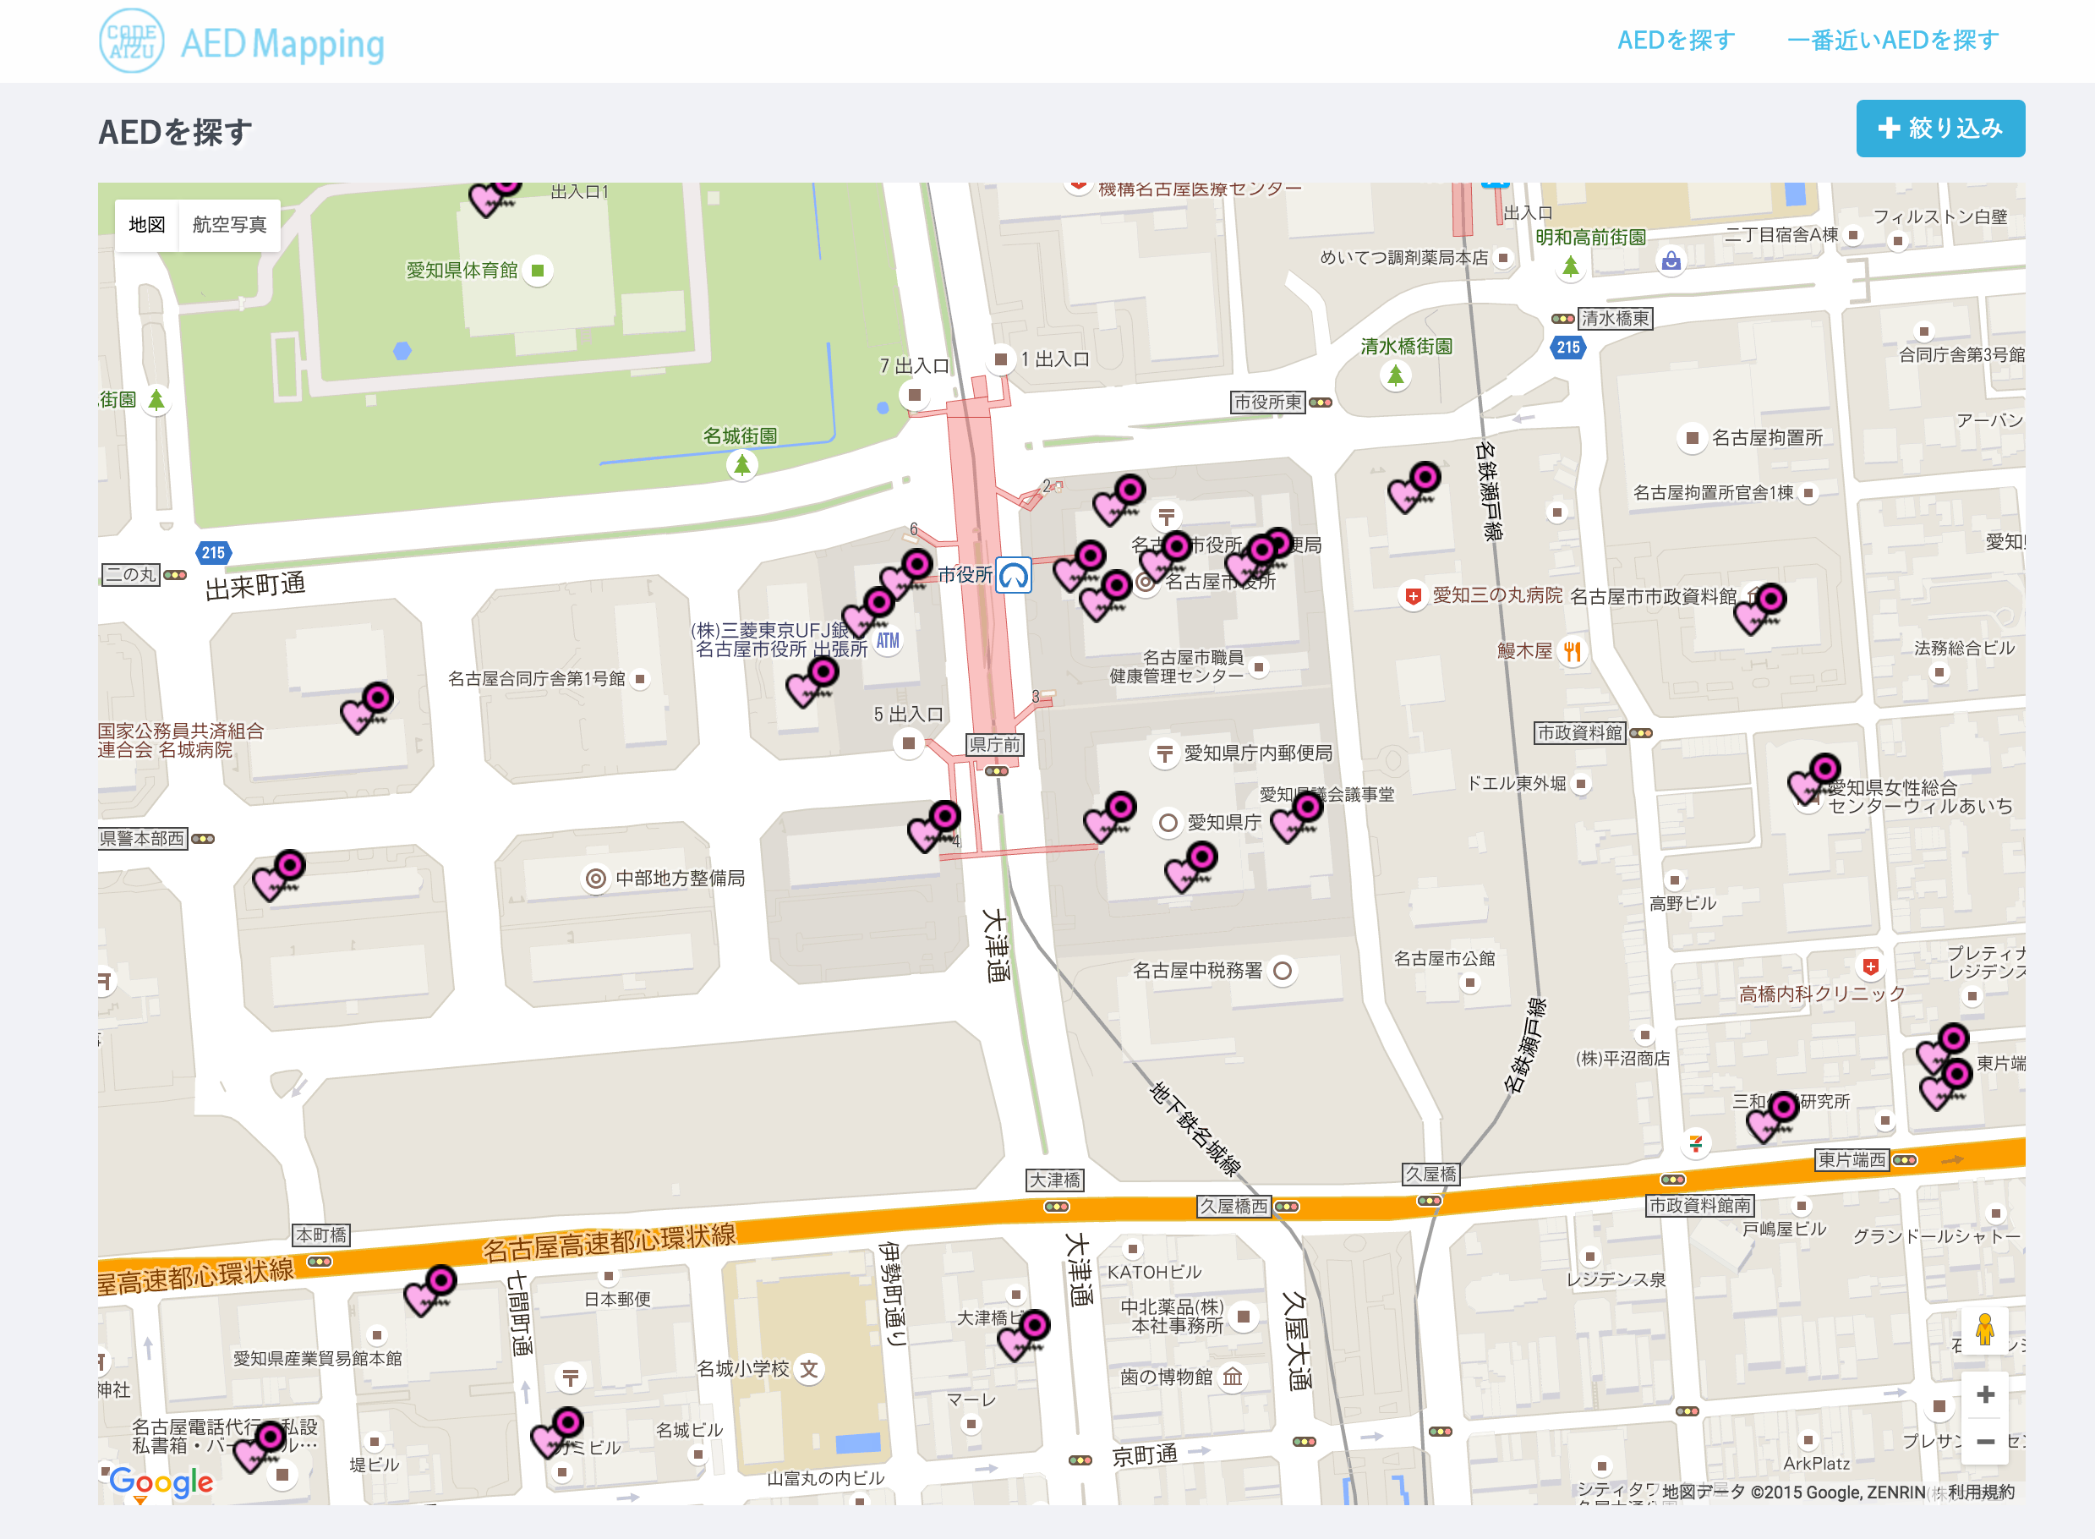
New Tools, etc. Originating from the Community-Originating Tools
Map for Locating AED within Aizu-wakamatsu by Code for Aizu

Slide 14








Corporate Fellowship Being Implemented where Businesses and Local Governments Cooperate with Each Other above and beyond their Respective Positions
Sabae CityｘSAP Japan
Kobe CityｘYahooｘCommunity Link
Yokohama CityｘMitssubishi
Research Institute,Inc. ｘFujitsu Lab. Ltd

Slide 15
Open Data ＝Tool for Cooperation

Slide 16

Data Disclosure
Creation of a community for Utilization
Project Implementation Support(Public-Private Sector Cooperation)
Unless these 3 requirements are concurrently met, the project effect will be limited.How many communities are aware of this in implementing projects?

Slide 17
At the same time, efforts are required to make the best use of data within the organization.
How much is being shared know-how on data utilization stocked within local governments ？

Slide 18
I thank you for your attention

