Slide 1
Regional Reviatalization ×AI
VLED Open Data Symposium 2015
Creating a Reginal Revitalization Platform
November 25, 2015
Kazuaki Murakami
Representative of Big Data & Open Data Study Group in Kyushu(BODIK)
Professor of University of Kyushu & Vice-President of Kyushu Institute of Systems, information Technologies and Nanotechnologies (ISIT),
Advisor of Kurume Open Data Utilization Promotion Study Group
1

Slide 2

BODIK
(Big Data & Open Data Study Gropup in Kyushu)
2

Slide 3
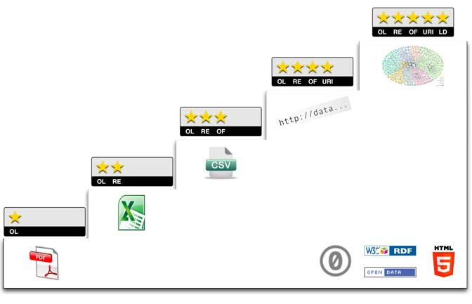




BODIK ODCS
BODIC.org
http://5stardata.info/ja/
3

Slide 4
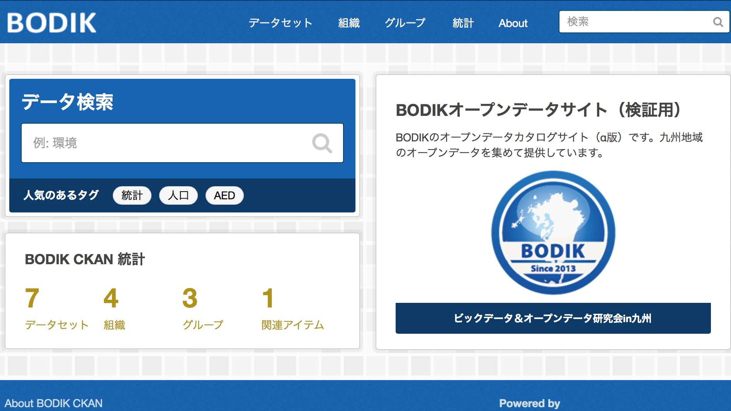
4

Slide 5

ODCS
(Open data Catalogue site）
BODIK ODCS
CKAN Base
Free of Charge
All Local Governments of Kyushu & Okinawa
From Fukuoka Pre., Fukuoka City, Kita-kyushuu city, Kurume City
Operated as from February 2016
http://5stardata.info/ja/
5

Slide 6
BODIK ODCS
BODIC.org
http://5stardata.info/ja/
6

Slide 7
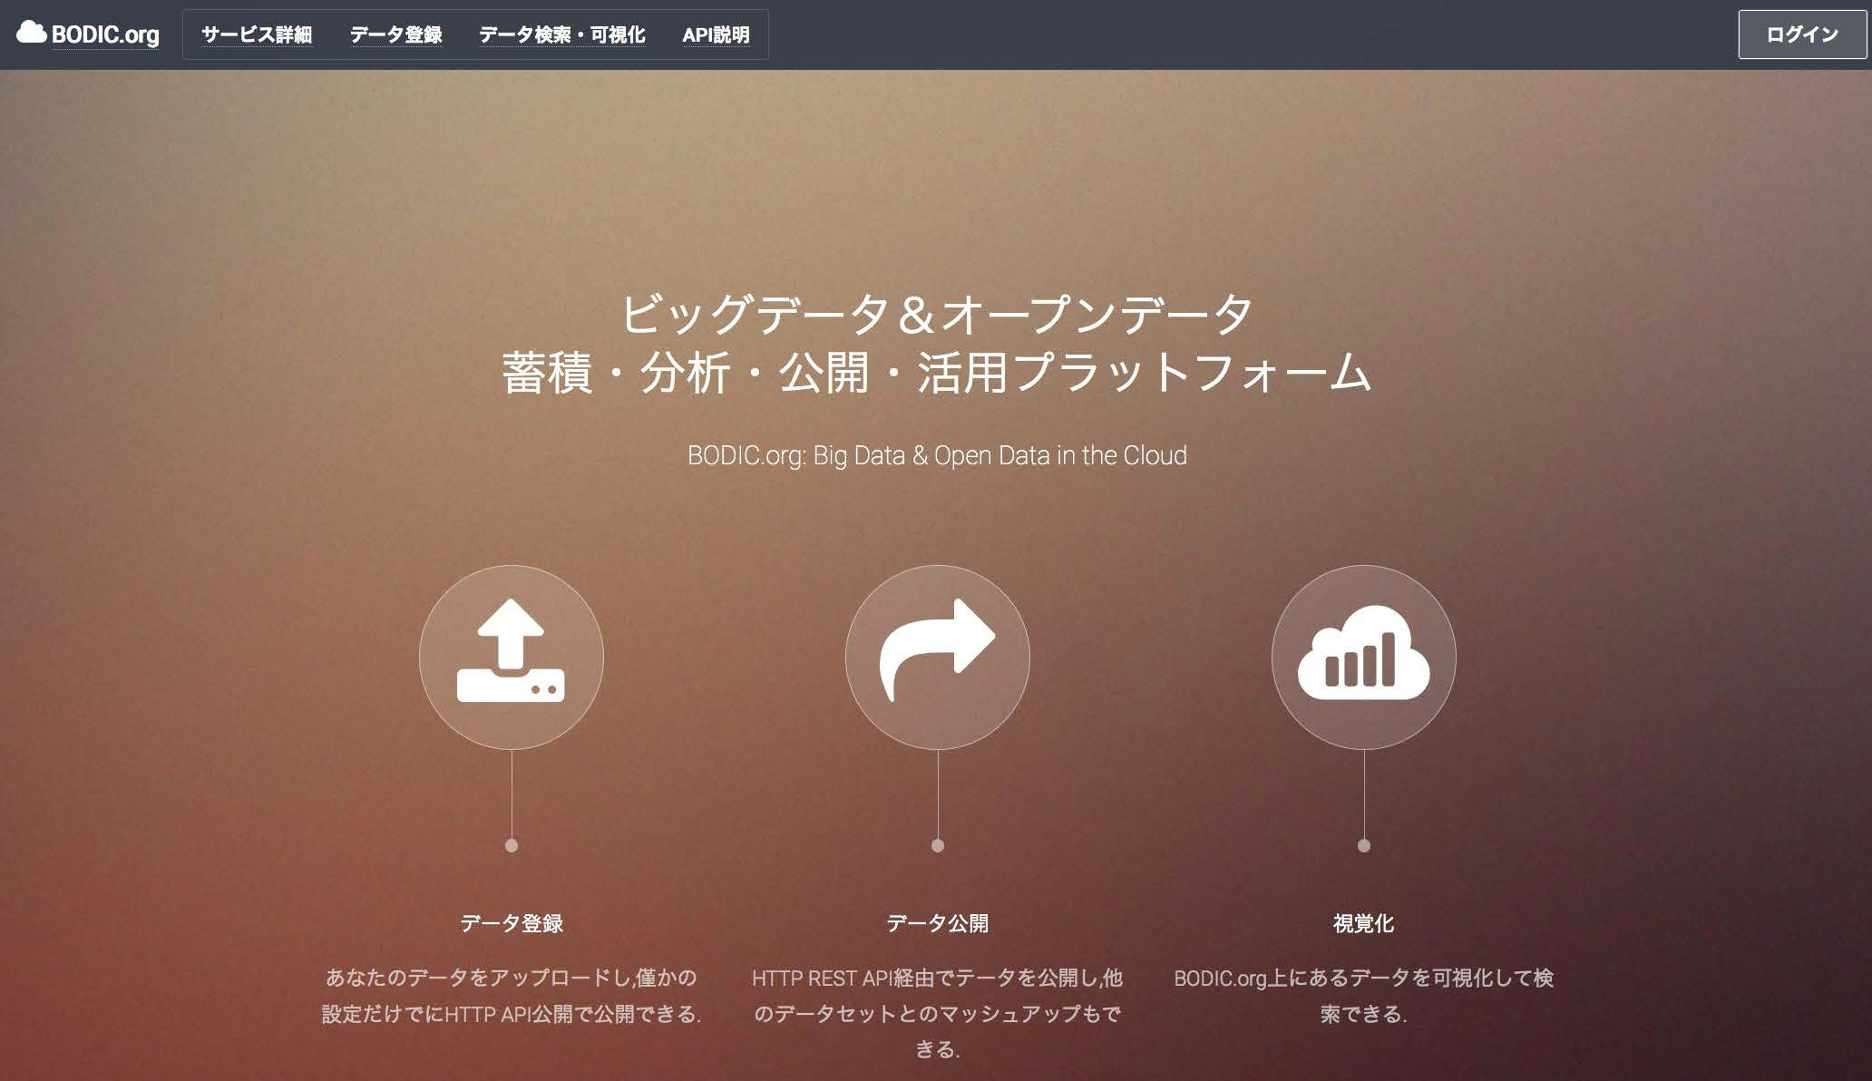
7

Slide 8

BODIC.org
(BigData&OpenData in the Cloud）
SPARQL Endpoint on AWS
Open Data Scrolled down from ODCS and Disclosed in RDFized & LODized Form
Reopened as from August 2015
www.bodic.org
BODIC.org
http://5stardata.info/ja/
8

Slide 9

BODIK
4 policies for Regional Revitalization
9

Slide 10

1. Redesign Social Systems
2. Open Data Ecosystem
3. Long Tale theory for Regional Revitalization
4. Platform for Regional Revitalization
10

Slide 11

1. Redesign Social Systems
2. Open Data Ecosystem
3. Long Tale theory for Regional Revitalization
4. Platform for Regional Revitalization
11

Slide 12
 | Conventional Social Services | Future Social Services
Examples | Conventional Government Services | Future Government Services
Target [Customers] | Local Residents | ?
Value [Value Offered] | Commodities | ?
Proﬁt [Earnings Model] | Taxes | ?
Capability [Management /Assets] | Local Government Officials Public Facilities | ?
12

Slide 13
 | Conventional Social Services | Future Social Services
Examples | Conventional Government Services | Future Government Services
Target [Customers] | Local Residents | ←
Value [Offered Value] | Commodities | ←
Profit [Earnings Model] | Taxes
Capability [Management /Assets] | Local Government Officials Public Facilities | Advertisment Model Freemium Model Open Data
13

Slide 14

1. Redesign Social Systems
2. Open Data Ecosystem
3. Long Tale theory for Regional Revitalization
4. Platform for Regional Revitalization
14

Slide 15
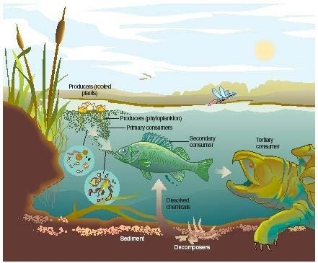



Open Data Business Model
Target[customers]
Value [Offered Value]
Profit [Earnings Model]
Capability [Management Assets/Operation]
Open Data Business
Platform
15

Slide 16

1. Redesign Social Systems
2. Open Data Ecosystem
3. Long Tale theory for Regional Revitalization
4. Platform for Regional Revitalization
16

Slide 17
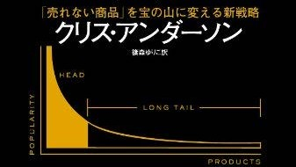

AFTER ICT
17
LongTail

Slide 18
BEFORE ICT
18
For Niche
1. No Production Means, or High Production Cost
2. No Distribution Means, or High Distribution Cost
3. Matching between Demand & Supply Impossible

Slide 19
ITC Makes possible
1. Democratization of Production Means
2. Democratization of Distribution Means
3. Matching between Demand & Supply
19

Slide 20
Reproducing
Long Tale through Regional Revitalization
20

Slide 21
21
Long Tale=Regions

Slide 22
From Hit-Oriented to Niche-Oriented
22

Slide 23
From Overconcentration-in-Tokyo Oriented Thinking to Regionalism-Oriented Thinking
23

Slide 24

1. Redesign Social Systems
2. Open Data Ecosystem
3. Long Tale theory for Regional Revitalization
4. Platform for Regional Revitalization
24

Slide 25


×
Open Data Ecosystem
Long Tale
25

Slide 26
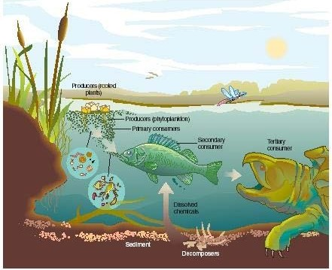



Open Data Ecosystem
Proﬁt [Earning Model]
Capability [Maja Management Assets /Operation
26
Open Data Business Model
Target[customers]
Value [Offered Value]
Profit [Earnings Model]
Capability [Management Assets/Operation]
Open Data Business Model
Target [customers]
Value [Offered Value]
Profit [Earnings Model]
Capability [Management Assets/Operation]
Open Data Business
Platform
Long Tale=Regions

Slide 27
To operate Open Data Ecosystem on Long Tale?
27

Slide 28
Platform on a Nationwide Scale is Required!
28

Slide 29

1. Redesign Social Systems
2. Open Data Ecosystem
3. Long Tale theory for Regional Revitalization
4. Platform for Regional Revitalization
29

Slide 30


Open Data Business Model
Target[customers]
Value [Offered Value]
Profit [Earnings Model]
Capability [Management Assets/Operation]
Open Data Business
Regional Revitalization Platform
30

Slide 31




















Citizens
★★★ Open Data
★★★★★ Open Data
Up-loading Agendas
BODIK ODCS
[All Local Governments]
Developing into RDF/LOD
AI
Engine
Government Data
DB
Agendas
DB
★★★★★ Open Data
C2B (Citizen-to-Business) BusinessMatch Platform
Government Data Up-Load
Business Recommendation
Ideas
DB
★★★★★ Open Data
BODIC.org
Skill Regfistration
Local Government Officials
Businesses (Open Data Business)
31

Slide 32


×
AI
Regional Revitalization
32

Slide 33




33

