Slide 1
Mission and Work Contents of the Technical Committee
Open Data Promotion Consortium
Ref. 1-4
2012.10.24.
This document is a provisional translation by Open Data Promotion Consortium

Slide 2
Background of Establishment of the Technical Committee
Rising Interest and Expectation for Open Data Utilization
  US : BUILDING A 21ST CENTURY DIGITAL GOVERNMENT (May, 2012)
    A memorandum issued by the Obama Administration which stated its intention of positive promotion of open data.
  EU: Open Data Strategy of Europe (end of 2011)
    It mentioned its position to support the research and development of data processing technology in the EU region. → UK and France have been actively making the public data open to the public and promoting their utilization.
  Australia : Open Government Declaration (2010)
    It declared the information owned by the public body is a valuable asset, and making the public information open to the public would generate new services and new public values.
  Japan : E-Government Open Data Strategy (July, 2012)
    It aims to promote the creation of new businesses and the optimization of business activities by provision of public data in the form that allows their secondary use.
Emergence of New Open Data
  The advancement of IoT (Internet of Things) technology prompted the movement of opening and sharing real-time information including sensor information.
    cosm (former Pachube)
    ThingSpeak
    OpenSense etc.
  Information of SNS (Social Network Service)
    Twitter
    Facebook
    Mixi etc.
Requirements for the Promotion of Open Data Utilization
  The government and local authorities must make their data open.
  Format Unification of Released Data
    It has been pointed out that data had been made open in PDF or JPEG format unsuitable for the secondary use; formats are different from office to office and it takes time for organizing collected data, etc.
It is indispensable to establish the technological standards to realize the environment to allow the distribution of various kinds of open data prepared and owned by the public and private sectors.

Slide 3

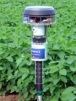
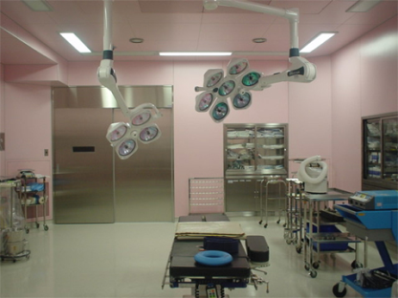
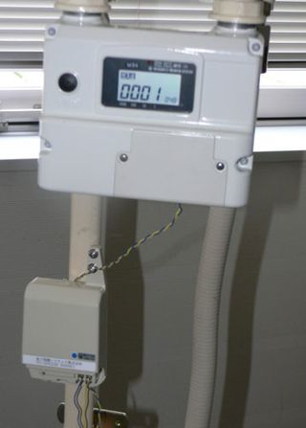



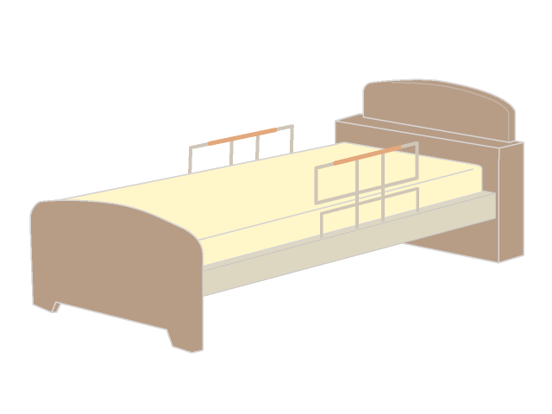



Open Data as the Target of Survey by the Technical Committee
Statistical Information
Geographical Information
  Public Facilities & Their Location
Sensor Data (Real –Time Data)
  Environment Info. (Temperature, Humidity, etc.), Energy Info., Biological Info., Public Transportation (Location, Traffic Obstruction Info.) etc.
Distribution / Traceability Information
  Product Inspection / Passage Record Info. Utilizing RFID etc.
  Product In-Out Record between Plural Corporations etc.
Disaster Prevention Information
  Meteorological Info., Monitoring of River and Public Facilities etc.
Characteristics of These Data
  Real-Time Data
  Data Size is Voluminous (Gbytes - Tbytes)
    Example : Monitoring of gas / water-supply / power meters of 100 households every 5 minutes for 1 month makes the data size as large as 100GB.
  Exposable data change in accordance with the situation.
    Example : The transaction information (product in-out record) in the category of traceability data is essentially non-exposable information.
    Only in case of accidents or problems of the product or food, the information is disclosed.
Healthcare Information
・Medical Checkup Record
・Exercise Record
・Medicine-Taking Record
Energy Information
・Smart Meter Info. Etc.
Disaster-Related Information
・Earthquake Data
・Radiation Dosage Data
Environment Information
・ Sensor Information etc.
Traceability-Related Info.
・Food Distribution Record
Info. etc.
Internet / Cell-Phone / Disaster Info. Communication Network etc.
Sensors on Farms /
Cultivated Lands
(Environment Info. Sensors)
Smart Meters
(Power, Gas, Water)
RFID R/W
SNS
(Human Sensor)
Environment Info.
Hospital / Medical Care Facilities Info.
Distribution & Traceability
Information
Social Information
Energy Information

Slide 4
Mission and Work Contents of the Technical Committee
Mission
  Consideration of Standard Technical Specifications (hereinafter referred to as Standard Specifications) for Realization of the Open Data as described in the above page.
    Data Standard
      Description Model of Open Data (The model to describe open data that is based on metadata.)
      Vocabulary to Describe Open Data (The standard dictionary to understand metadata.)
    Standard API
      Rules regarding Standard Method to Acquire and Exchange Open Data
  Consideration of Works for International Standardization
    ITU-T, W3C, …
Work Contents
  Discussion on the Condition of the Standard Specifications
    Exchange of Views on the draft Standard Specifications
    Organization of Existing Similar Standards etc. and Consideration of the Consistency with Them
      NIEM of the US／ISA of Europe／Meteorological Metadata of the Meteorological Agency of Japan
      CKAN / LOV (Linked Open Vocabulary)
    Hearings about Technical Requirements from the Utilization and Promotion Committee etc. and Consideration of Reflection to the draft Standard Specifications based on the Requirements.
    Technical Consideration of License Expression of Data Governance, and Data Processing (after the 2nd Year)
  Discussion on the International Standardization Activities
    Trend Survey on the Standardization, Hearings and Discussion about the Standardization System in the 1st Year.
Expected Output
  Activity Report (including the Standard Specifications)

Slide 5
Position and Composition of the Technical Committee
Technical
Committee
Report of
Consideration
Progress
Committee Members
Koshizuka, Senior Researcher
Takeda, Researcher
Fukami, Deliberative Member
Nakao, Deliberative Member
Hiramoto, Deliberative Member
Utilization &
Dissemination
Committee
Secretariat
Feedback for
Standard
Specifications
Discussion of the Conditions
of the Standard Specifications
Data Governance
Committee
Report of
Consideration Progress
Observers
Ministry of Communications, IT Strategy Office of the Cabinet Secretariat,
METI, Geospatial Information Authority of Japan,
Cabinet Office (Disaster Prevention)
Invitees
Requirements of
Expression of
Data Governance Rules
Reflection to the draft Standard Specifications
(Proposed Technical Requirements)
(*) Further Description on “Standard Specifications” in the next page.

Slide 6
Work Contents of the Technical Committee
(for 3 Years) (Draft)
 | 1st Year | 2nd Year | 3rd Year
Basic Principle of the Work | Consideration of Standard Specifications / Trend Survey of Standardization Activities | Close Examination of Standard Specifications / Environment Creation for Standardization | Close Examination of Standard Specifications / Proposal of Standardization
Major Study Items | Consideration of Standard Specifications based on the draft (Sorting Out the Items for Standardization) Trend Survey of Standardization Consideration of System of Standardization Activities (Invitation of Collaborators) | Close Examination of Standard Specifications Responses to the Technical Requirements provided by the Data Governance and Utilization & Dissemination Committees Improvement of Specifications through the Practice on Concrete Open Data Consideration of Subsidiary Technical Documents and Tools in connection with Standard Specifications (Usage Guide, Operation System, etc.) Consideration of System of Standardization Activities including Foreign Countries (Invitation of Collaborators) | In Continuation of the 2nd Year, Refinement of Standard Specifications Close Examination of Subsidiary Technical Documents and Tools in connection with Standard Specifications (including Practical Operation in Accordance with Study Items) Report of Standardization Activities and Discussion
Technical Requirements from Data Governance and Utilization and Promotion Committees
Acquisition of Concrete Open Data in Accordance with Study Items

Slide 7
Work Contents of the Technical Committee
(for the 1st Year) (Draft)
Committee Meetings (Approximate Timing) | Title
1st Meeting (Today) | Introduction of Participants and Discussion on the Way of Operation of the Committee Awareness Coordination regarding Technical Matters of Open Data Distribution Introduction of Preliminary Draft of Standard Specifications
2nd Meeting (Nov. to Dec.) | Discussion of Draft Standard Specifications Report of Survey on Similar Systems and Specifications
3rd Meeting (Jan.) | Discussion on Draft Standard Specifications Discussion on International Trend of Standardization
4th Meeting (Feb.) | Discussion on Draft Standard Specifications Consideration of Issues arising from the Technical Requirements provided by the Utilization and Promotion Committee Discussion on International Standardization System and Items for Standardization Discussion on the Report of Activities of the Year Discussion on the Planned Activities of the Next Year

