Slide 1
Open Data Activities of
the Ministry of Communications
December 9, 2013
Content Distribution Promotion Division,
Information and Communications Bureau,
Ministry of Internal Affairs and Communications

Slide 2
Activities of the Ministry of Communications (Overall Picture)
Environment Consolidation for Open Data
１. Open Data Verification Test
○ Implementation of the Open Data Verification Test aiming at 1) the establishment of the common API which is the base for collaboration for data circulation, and international standardization, 2) the rule setting for the secondary utilization of data, and 3) the visualization of merits of open data, all of which are essential for effective data distribution, utilization and collaboration beyond boundaries of different fields.
２. Collaboration with Open Data Promotion Consortium
○ Ministry of Communications will implement, in collaboration with the Open Data Promotion Consortium, 1) the consideration of technical specifications for open data, 2) the consideration of rules for the secondary utilization of data, and 3) the information dissemination of the importance and possibilities of open data.
Advanced Approach
３. Advancing Open Data from the Communications Ministry
○ Implementation of the advanced approach, as one of data-owning institutions, to showcase the model to be followed by other government organizations.
・Open data realization of the White Paper of Information Communications and the Statistical Database of Information Communications (together with the adoption of conditions of free utilization, CSV format)
・Improved open data provision in the field of statistics (provision of API, etc.)

Slide 3
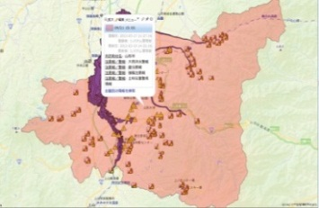
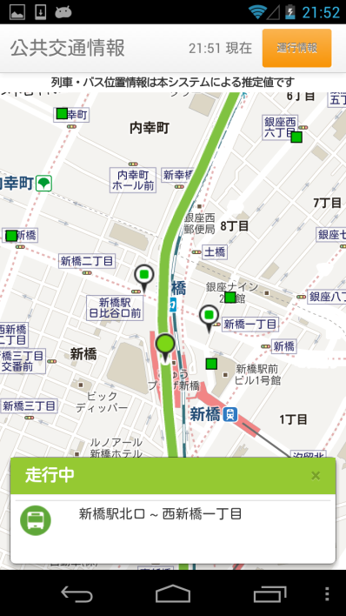
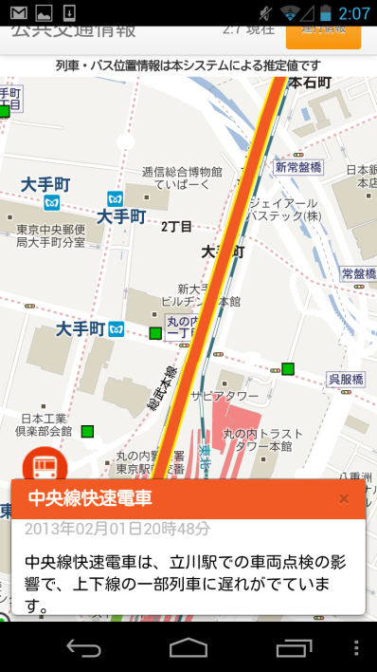
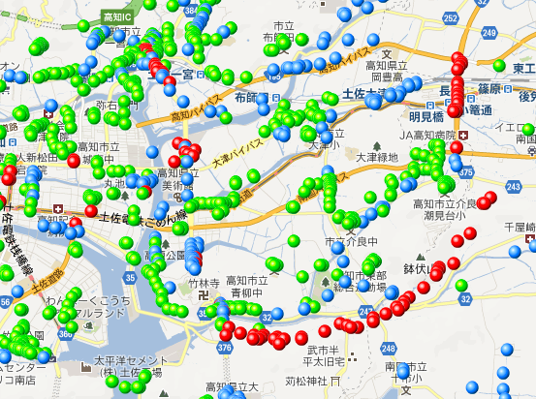




Open Data Verification Test (Outline)
○ eImplementation of the Open Data Verification Test aiming at 1) the establishment of the common API ※ (normal data standards, normal API standards) which is the base for collaboration for data circulation, and international standardization, 2) the rule setting for the secondary utilization of data (data governance system), and 3) the visualization of merits of open data, all of which are essential for effective data distribution, utilization and collaboration beyond boundaries of different fields.
※ Common API (Application Programming Interface) ： Common data format and communications regulations to ensure the Interoperability of information and data
Disaster Prevention
Information Service
Public Transportation
Information Service
Ground Information Service
Flood Risk Area
List Display of Ground Information at Towns, Cities and National Levels
Delay Info.
Evacuation Advisory Area
Real Time Position Information
Combination of Various Information
Common API for Collaboration for
Data Circulation
Local Authorities Adm. Info.
Social Capital
Info.
Tourism Info.
Disaster Prevention Info.
Public Transport Info.
Statistical Info.
Pollen Forecast Info.
・ Based on the results of the verification test of the fiscal 2012, etc., comments were invited on the Common API Base for Collaboration for Data Circulation (1st version) up until Oct. 10, 2013. http://www.opendata.gr.jp/cfc/
・ In the fiscal 2013, seven verification tests are being implemented, including local authorities’ administrative information, social capital information, tourism information and disaster prevention information, etc., for the preparation of the Common API Base for Collaboration for Data Circulation (2nd version) to be completed by the end of the fiscal year.

Slide 4


Open Data Verification Test in the Fiscal 2013 (Example) 1) Local Authorities’ Adm. Info.
Verification Test for Open Data of Information Administered by Local Authorities was Implemented in Collaboration with Cities of Yokohama and Sabae.
Responsible Organizations ：NTT Data (LOD Initiatives, Microsoft Japan, Indigo, jig.jp)
Collaborative Organizations ：Yokohama City, Sabae City
【Investigation for Identification of Administrative Information in Prioritized Local Authorities】
・Investigation of needs for data utilization.
・Investigation of grounds of disapproval of data release and secondary utilization.
等
【Preparation of Data Standards】
【Infrastructure Development for Collaboration for Data Circulation】
・Simple system design.
・Documentation of design concept and procedures, etc.
・Preparation of data conversion tools
・Preparation of manuals for staff of local authorities, etc.
【Verification of Open Data Realization of Administrative Information of Local Authorities】
・Webpage-based release of administrative information of prioritized local authorities, and construction of specific portal site.
Service Users
（Local Residents）
Service Users
（Information Service Developers)
Data Portal
Data Providers
(Staff of Local Authorities)
2 Identification
System for Collaboration for Data Circulation
1 Registration
Data Conversion Tool
Manuals
3 Content Confirmation
5 Service Provision
Vocabularies
RDF Schema
4 Data Acquisition
【Application Developed in the Contest】
・Developers’ websites
Information Database of Local Authorities
3

Slide 5

Open Data Verification Test in the Fiscal 2013 (Example) 2) Public Transport Info.
Provision of Public Transportation Information including Railways, Buses and Stations, etc. in Collaboration with Public Transportation Servicers in Tokyo Metropolitan Area.
Responsible Organization： Yokosuka Telecom Research Park, Inc.
Collaborative Organizations： Research Society for Public Transportation Open Data
(Members : Odakyu Electric Railway Co.; Keio Co., Keikyu Co.; Metropolitan Intercity Railway Co.; Tokyu Co.; Tokyo Metro Co.; Bureau of Transportation, Tokyo; TOBU Railway Co.; Tokyo Waterfront Area Rapid Transit, Inc.; East Japan Railway Co.; Tokyo Waterfront New Transit YURIKAMOME; Japan Airport Terminal Co.; Ubiquitous Information Infrastructure Research Center, Interfaculty Initiative in Information Studies, the University of Tokyo; Yokosuka Telecom Research Park, Inc.)
Information Service Developers’ Sites
Data for Provision
Documents on API
Sample Programs
Libraries, etc.
Public Transportation
Information Service
Public Transportation
Information Service
Application Developed in the Contest
Provision
Common API for Collaboration for
Data Circulation
Reflection
【Guideline for Open Data Realization of Public Transportation Information】
Procedures for Open Data Realization
Demarcation of Rights and Responsibilities of Public Transportation Facilities
Points to Note for Information Service Developers and Public Transport Service Users in Terms of Utilization of Public Transportation Information Service
・Time Table Information
・Real Time Position Info.
・Delay / Service
Suspension Info.
・Facility Info. (Ticket Gates, Shops)
・Weather Info. (Temperature,
Moisture)
・Parking Lot Info.
・Time Table Info.
・Operation Info.
Data to be Used in the Verification Test
Railway Operators
Station / Airport Terminal Operators
Bus Operators
9 Operators with
More than 45 Lines
Stations of Tokyo
& Shinjuku
Metropolitan Bus
(in Tokyo Area)
Notes:
4

Slide 6
Open Data Verification Test in the Fiscal 2013 (Example) 3) Tourism Info.
Provision of High Level Navigation, in Collaboration with Kyoto City, etc., for Encouraging Park & Ride, etc.
Responsible Organization ： IBM Japan, Ltd.
Collaborative Organizations ：Kyoto City, etc.
Citizens
Tourists
Local Authorities
Information Service
Developers
Service Developers’ Websites
Specifications of API
Sample Code
Rules of Data Utilization, etc.
High Level Navigation System
Tourist Guide Navigation System
Navigation System at the Time of Disaster
Application Developed in the Contest
Provision
Common API for Information Distribution Collaboration
【Data Used in the Verification Test (Example)】
● Mobility Info.
Public Transport Route Info., Time Table Info., Bus Stop Info., Parking Lot Info., Average Bus Traveling Time Info., Average Taxi Traveling Time Info.
● Tourism Info.
Public Facilities Info., Lodging Info., Souvenir Shop Info., Tourist Facilities Info.
● Disaster Prevention Info.
Shelter Info., Disaster Prevention Base Info., Info. of Support Stations to People Having Difficulties Returning Home
Probe Analysis
Mobility Info.
Tourism Info.
Disaster Prevention
Info.
Parking Lots
Position Info.
Full / Vacancy
Info.
Transport
(Bus, Subway,
Taxi, Station, Position Info., Probe Info.
Public Facilities
Position Info.,
Basic Data
Inns, Souvenir Shops
Position Info.,
Basic Data
Tourist Facilities
Position Info.,
Basic Data
Disaster Prevention
Position Info.,
Shelters, Disaster Prevention Bases,
Support to People Having Difficulties Returning Home
Notes:
5

Slide 7
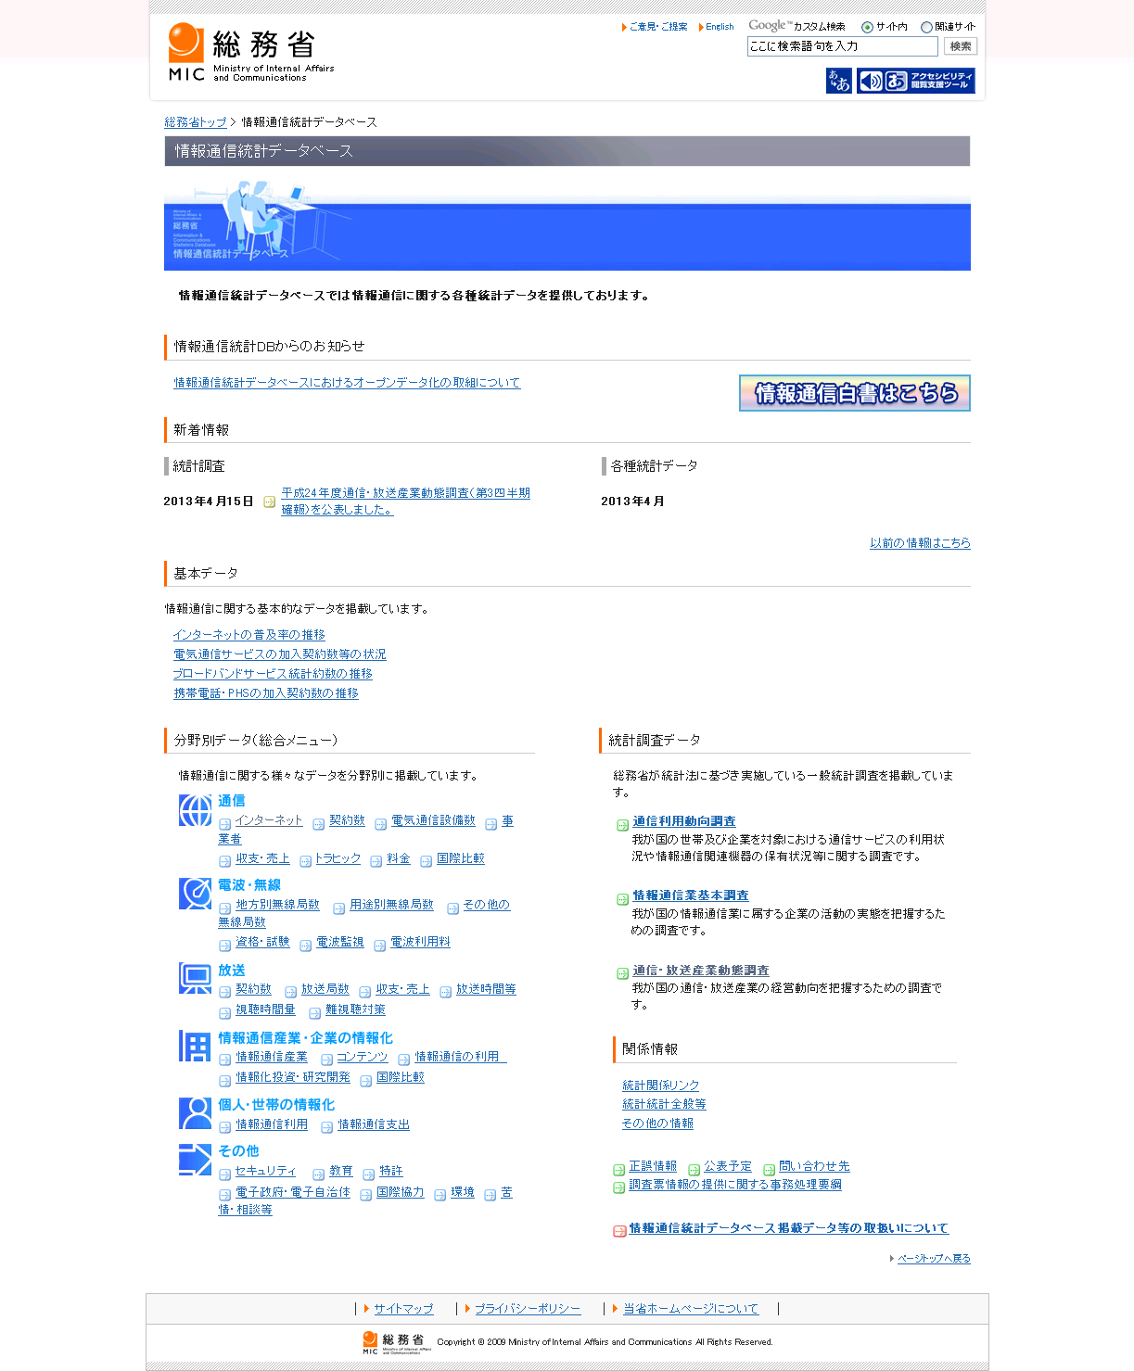
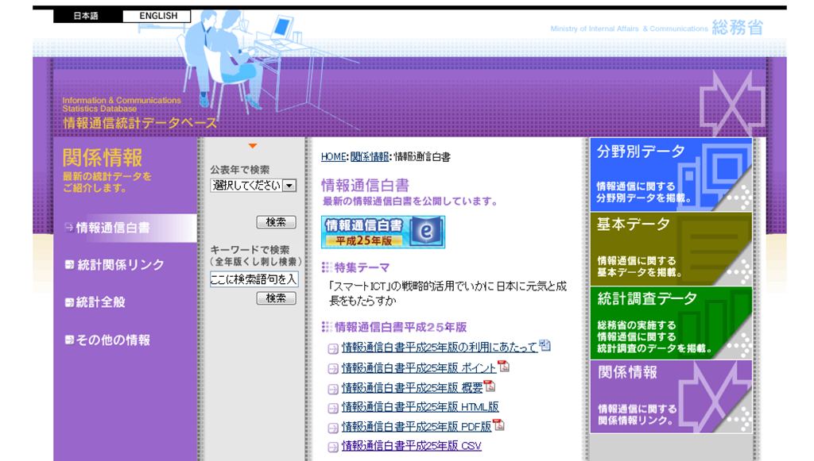
Open Data Realization of Information Owned by Communications Ministry 1) White Paper of Information Communications
○ Based on the results of case studies undertaken, in the fiscal 2012, by the Data Governance Committee of the Open Data Promotion Consortium, the Communications Ministry implemented the open data realization of the White Paper of Information Communications as a model of open data realization of the government-owned information.
White Papers of Information Communications (2008 to 2013 editions) were posted on open data.
○ The free secondary utilization of the documents
is allowed in principle.
○ Non-possession of copyrights of numerical data
by the Ministry is clearly mentioned.
○ Provision of numerical data not only in Excel format but also in more machine-reading-friendly CSV format.
In addition to the description of the free secondary data utilization, the conditions of usage of the data are also defined by the Creative Commons License (CC – BY).
Downloading of CSV data is possible.
Clear description of non-possession of copyrights of numerical data

Slide 8
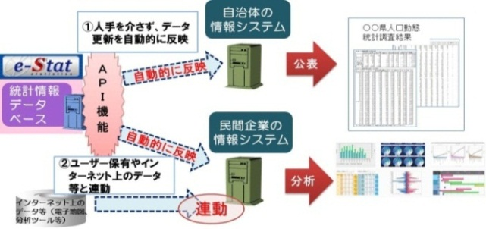
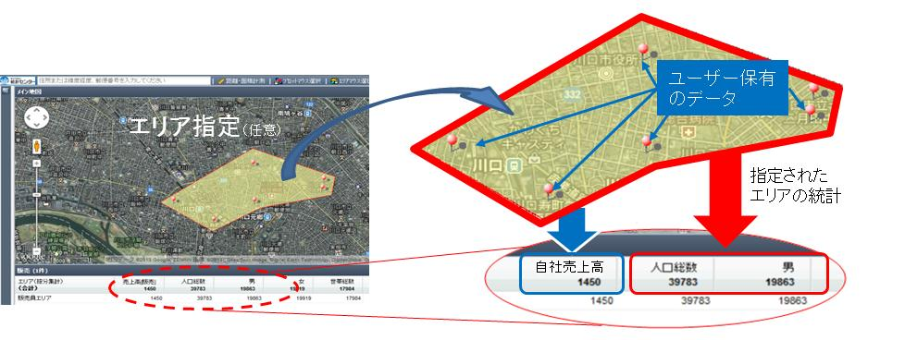
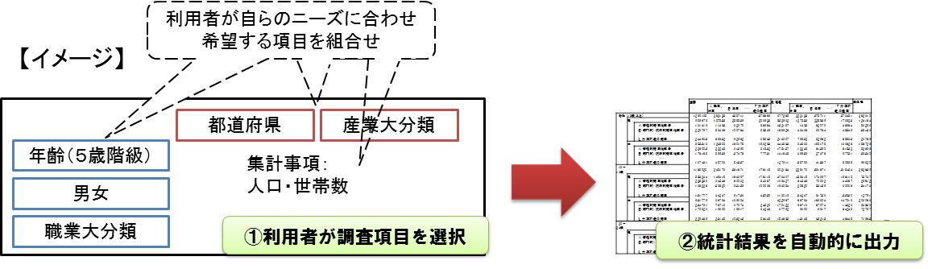
Open Data Realization of Information Owned by Communications Ministry 2) Statistics
1. Development of High Level Use Environment of Statistical Data by API Function
  ○ The addition of API function to the existing government statistical portal site
  “e-Stat” has made the followings possible:
  ① Automatic reflection of e-Stat data to the information systems of data users.
  ② High level statistical data analysis interlinked with data of users and those
  available through internet.
  ○ The trial operation started on June 10, 2013. (http://statdb.nstac.go.jp/)
2. Strengthened Statistical GIS Functions
  ○ The statistical GIS function of e-Stat was strengthened to make data acquisition from data users’ system as well as data usage of arbitrarily designated areas possible.
  ○ The trial operation started on October 18, 2013. (http://statdb.nstac.go.jp/)
3. Research on Functions and Measures of On-Demand Statistic Production
○ The research on a new statistic provision service which automatically produces statistical results in response to the users’ selection of study items is on-going.

Slide 9





Open Data Application Contest
(Announced : Nov. 28, 2013)
○ The Ministry of Communications has been implementing the Open Data Verification Test for the establishment of the technology and utilization rules of open data, and visualization of merits of open data. In this connection, for the promotion of utilization of open data produced by the public sector for the usage by the private sector, the Ministry calls for the application development for the use for the seven open data being tested in the Verification Test. This application development is conducted through the public subscription.
Organizers
Ministry of Communications, and Open Data Promotion Consortium
Co-sponsors
NTT Data Co., Fujitsu, Ltd., IBM Japan, Ltd., NTT Data Institute of Management Consulting, Inc., PASCO Co., Yokosuka Telecom Research Park, Inc., Weather Service Co.
Supporters
OpenStreetMap Foundation Japan, Open Knowledge Foundation Japan, Creative Commons Japan, Code For Japan, Hack For Japan,
Big Data Open Data Utilization Promotion Association, Linked Open Data Initiative ※ Some others in negotiation
Commendation
Verification Test and Public Data used as Open Data
Verification Test | Public Data to be used as Open Data (Examples)
Local Authorities Adm. Info. | Medical Facilities Info., Bus Stop Positioning Info., AED Positioning Info.
Social Capital Info. | Construction Result Info., Social Capital Info., Complaint / Inquiry Info.
Tourism Info. | Tourist Info., Full / Vacancy Info. by Parking Lot, Taxi Traveling Time
Disaster Prevention Info. | Shelter Info., Past Disaster Info., Life-Line Damage / Recovery Info.
Public Transport Info. | Delay / Service Suspension Info., Running Position Info., Station Info.
Statistical / Data Catalogue Info. | Statistical Data of Statistics Bureau, Communications Ministry, Info. posted on the government data catalogue site (trial version)
Pollen Forecast Info. | Airborne Pollen Level Info., Weather Info., Hay Fever Symptom Info. etc.
Application Development by Public Subscription
Local Authorities Adm. Info.
Common API for Information Distribution Collaboration
Schedule
Pollen Info.
2013 | Nov. 28 (Thu.) | Announcement
2014 | Early Jan. to Late Jan. | Inauguration of Service Developers‘ Sites / Start of Data Provision
 | Feb. 3 (Mon.) | Start of Receiving of Application
 | Feb.17(Mon) Noon | Closure of Receiving of Application 【Strictly Observed】
 | Mar. 3 (Mon.) 10～12 | 4th Utilization & Dissemination Committee Meeting (Presentation by Prize Winners & Award Ceremony)
Social Capital Info.
Statistical Info.
Tourism Info.
Disaster Prevention Info.
Public Transport Info.
※ For details, see the website exclusively for the contest of the Open Data Promotion Consortium. (http://www.opendata.gr.jp/2013contest/)

